Slide 1
Virtual Security architects of information security company- Portfolio

Slide 2
Table of content
S. No | Description | PG #
1 | Company Profile | 4
2 | Security Assessment Approaches & Methodologies | 7
3 | Information Security Risk Assessment | 18
4 | Digital Forensics | 26
5 | OT Cyber Security Services | 45
6 | Managed SOC | 53
7 | Business Continuity & Disaster Recovery | 56
8 | Cyber Threat Intelligence | 61
9 | Cyber Drills | 65
10 | IT Due Diligence | 70
11 | Compromise Assessment | 73

Slide 3
Table of content
S. No | Description | PG #
12 | Cyber Security – Readiness & Maturity assessment | 76
13 | PCI/DSS Readiness Assessment | 78
14 | List of Licensed / Open Source Tools | 82
15 | Cyber Security Trainings for Corporate Sectors | 91
16 | Virtual Security (Cyber & iLAB Setup) | 93
17 | Final Year Projects Ideas | 100
18 | Team Profiles | 102
19 | Global Certifications | 119
20 | Customer References | 146
21 | Association & Partnership | 150
22 | Contact Us | 152

Slide 4
Company Profile

Slide 5
Company Profile
The leading name in the field of computer science and technology. Our motive is to provide security across the network which is the requirement of today’s environment. Virtual Security has established their presence in the Market since 2015, our market focused captured many external projects associated with Middle East. Our criteria for selecting a candidate is to adopt associates and make them professionals, our dedication and workmanship is associated to Information Security Management Systems and to provide a result oriented solutions to our prestigious clients. We have a verity of self-created solutions build on the basis of ISO standards and Industry best practices.
Virtual Security has the uniqueness in their products. Virtual security products are self-developed and in-house build solutions based on the standard that meet the compliance.
Virtual Security customized solution includes:-
Data Leakage Protection;
OT /IOT Cyber security Services;
Open Source Cross Platform solution assessment (Word press, Joomla;
Project Honey Ne;
Intrusion Detection & prevention Solution(s;
System Performance & Security Enhancer
Identify & alert illegal / Unofficial presence of a company over the Internet
Mobile Application Security Assessment
Policies and procedures – Technical tool for assessing the security setting of servers and network devices

Slide 6
Company Profile – Team Structure
Managing Partner
Ambreen Siddiqui
Client relationship Manager
(Syed Hassan Alam)
Team Lead
(Innayat Hussain)
Advisors/Consultants
Project Manager (Shujaat Hussain)
SME (Subject Matter Experts) / Remote Working
(Remote Teams)

Slide 7
Security Assessment
Approach & methodologies

Slide 8
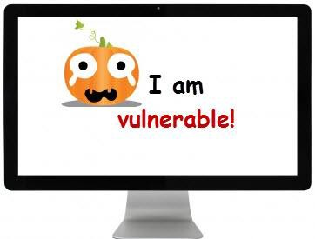
Vulnerability Assessment & Penetration Testing
Our Vulnerability Assessment & Penetration testing includes initially a security assessment questionnaire in which we acquire the details of the system(s) which needs to be assessed by the client, after the questionnaire is received from the client we make a proposal containing (Our Approach, Methodology, Tools, Timelines, Project Costing, Client References, Team profiles). When the proposal goes to the awarding stage we submit an Engagement Letter along with an Authorization letter which contains the details of the assessment to be performed from the our Pakistan Lab using our dedicated IP addresses, the whole activity is controlled and the complete testing done by our specialized tester specially trained for doing Automated/Manual vulnerability assessment & Penetration Testing, automated penetration testing includes a complete comprehensive test that exclude the presence of False Positive events and our successful security assessment & Penetration testing approaches includes :
Role based Penetration Technique: Dummy user credentials are assigned to the Pentester in order to test the environment completely.
Manual Penetration technique: This technique includes the hands on exercise and practice performed by the pentester, In Normal cases Manual testing is a part of white box testing.
Black Box/Blind Penetration Technique: Pentester doesn’t know about any information regarding your Network, Only a single wire Unleashed all the loop holes in the Network.
Double Blind Penetration Technique: This Method is very aggressive when a Company wants to evaluate their Information Security and I.T teams by assigning a Task to our pentester, In these types of testing I.T Head doesn’t inform their Team about the activity that is going to be conducted by the pentester and including pentester considering that they are unaware about your network as they are performing Black Box Testing. In Simple words both parties do not know about the network activities and behavior.
White Box Penetration Technique: When performing a White Box testing Organization provides a list of IP Address with operating system details, Device model and configurations are provided to the pentester in order to assist their security mechanism.
Grey Box Penetration Technique: In This type of pentesting organization gives half of the knowledge to the pentester and help pentester to perform the activity accordingly, normally this testing help pentesters to get some little knowledge about the networks.

Slide 9
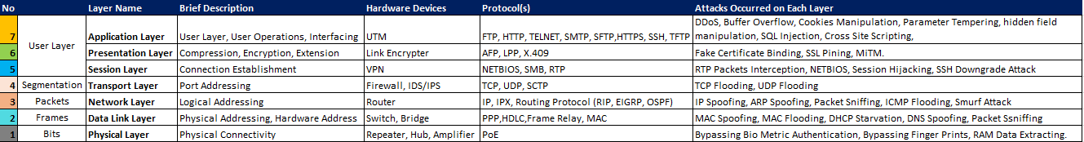
Vulnerability Assessment & Penetration Testing (Cont’d…)
For Vulnerability Assessment & Penetration testing, virtual security has a unique approach for assessing the vulnerabilities through 7 layers Security assessment, for each device we ensure to assess the device using every possible attack which the device can face in term of Physical and Application level.

Slide 10
VA/PT – Black box Approach
The objective of Black box penetration testing has two primary goals:
External pentest to ensure they have a strong perimeter security controls in place; and
Internal pentest to discover weaknesses that could be exploited by an attacker who gains a foothold in the environment;
Our Black Box vulnerability Assessment & penetration testing approach includes evaluation of externally facing assets to identify how an adversary can identify and exploit the weakness to penetrate in the network:
Following are the approach which virtual security utilizes while conducting Black Box penetration testing:
External penetration testing
Requires approval and authorization from client, while conducting Black box pentest virtual security provides its Static Public IP Address to ensure that an authenticated pentest activity is being conducted from their IP Address.
The scope of work in Black Box penetration testing is not finalized at initial level, however once the IP Address, domains and other information extracted y Virtual security and they provide it to the client, the client than confirms whether which IP Address, domain are required to qualified for penetration testing;
No information is taken from the client regarding Infrastructure, network diagram, host addresses, domain names, URL’s, credentials, and testing environment.
The activity is completely includes unauthenticated pentest which may includes either OWASP Top 10 and/or OSVDB / CWE methodology.

Slide 11
VA/PT – Black box Approach
Internal penetration testing
Requires approval and authorization from client, while conducting Black box pentest in ine internal environment. Our team only requires a network access (whether restricted or unrestricted), and start testing from that point;
If there is any trouble required during the internal network connectivity or Team failed to connect directly in the internal environment, our team send an email regarding they were unable to access in the network and requires Network reachability.
As soon as the network reachability achieved our testing starts from:
  Host Discovery
  Enumeration
  Scanning
  Vulnerability Identification and Verification
  Exploitation (if approved by the client)
  Draft Observations
  Discussion on Draft Observations with relevant stake holders
  Report submission

Slide 12
VA/PT – WHITE box Approach
The objective of White box penetration testing has two primary goals:
To Make sure whether an authenticated user can access and exploit the system security and priviledges’
To ensure security controls and servers in terms of security controls are actively working and hardened or requires improvement.
Following are the approach which virtual security utilizes while conducting White Box penetration testing:
External penetration testing
Our white Box vulnerability Assessment & penetration testing approach includes:
Getting List of IP Addresses / Domain names / URL’s from client;
Receive dummy credentials for assessing web/mobile applications and servers;
Requires approval and authorization from client, while conducting white box pentest virtual security provides its Static Public IP Address to ensure that an authenticated pentest activity is being conducted from their IP Address.
The scope of work in White Box penetration testing is finalized before the activity has been initiated, and the assessment is carried out against the defined scope of work;
Information including Infrastructure connectivity, network diagram, host addresses, domain names, URL’s, credentials, and testing environment is provided by the client.
The activity time, date, day is being informed and communicated to the point of contact nominated from client side.

Slide 13
VA/PT – White box Approach
Internal penetration testing
Requires approval and authorization from client, while conducting White box pentest in internal environment. Our team requires unrestricted network access by providing our System IP Address, MAC Address and Hostname if required by the client;
Testing credentials, whitelisting of IP Address in firewall and other devices is done by the client.
As soon as the network reachability achieved our testing starts from:
  Enumeration (In Scope Inventory)
  Scanning (In Scope Inventory)
  Vulnerability Identification and Verification
  Exploitation (if approved by the client)
  Draft Observations
  Discussion on Draft Observations with relevant stake holders
  Report submission

Slide 14
VA/PT – GRAY box Approach
The objective of Gray box penetration testing has two primary goals:
To ensure and find out possible ways whether an intruder can penetrate in the environment having a limited information of a network;
To ensure security controls and servers in terms of security controls are actively working and hardened or requires improvement.
Following are the approach which virtual security utilizes while conducting Gray Box penetration testing:
External penetration testing
Our Gray Box vulnerability Assessment & penetration testing approach includes:
Getting List of either IP Addresses / Domain names / or URL’s from client;
Receive dummy credentials for assessing web/mobile applications and servers (if possible);
Requires approval and authorization from client, while conducting white box pentest virtual security provides its Static Public IP Address to ensure that an authenticated pentest activity is being conducted from their IP Address.
The scope of work in Gray Box penetration testing is finalized before the activity has been initiated, and the assessment is carried out against the defined scope of work;
Information including Infrastructure connectivity, network diagram, host addresses, domain names, URL’s, credentials, and testing environment is provided by the client (If possible);
The activity time, date, day is being informed and communicated to the point of contact nominated from client side.

Slide 15
VA/PT – Gray box Approach
Internal penetration testing
Requires approval and authorization from client, while conducting Gray box pentest in internal environment. Our team requires unrestricted network access by providing our System IP Address, MAC Address and Hostname if required by the client;
Testing credentials, whitelisting of IP Address in firewall and other devices is done by the client (If possible).
As soon as the network reachability achieved our testing starts from:
  Enumeration (In Scope Inventory)
  Scanning (In Scope Inventory)
  Vulnerability Identification and Verification
  Exploitation (if approved by the client)
  Draft Observations
  Discussion on Draft Observations with relevant stake holders
  Report submission

Slide 16
Security Assessment – Mobile Application (cont’d…)
Mobile Device | Integrated System(s) | Integrated Network | Mobile App Backend
Browser Phishing Framing Click Jacking Man-in-the-Middle Buffer Overflow Parameter Tempering | Operating System Password management Jail breaking / rooting OS data caching Data access Carrier-loaded software Zero-day exploit | Communication Channels No / weak Wi-Fi encryption Rogue access point Packet sniffing Man-in-the-middle Session hijacking DNS poisoning Fake SSL certificate | Web Server Platform vulnerabilities Server misconfiguration Cross-site scripting Cross-site request forgery Weak input validation Brute force attacks
Application Sensitive Data storage No / Weak encryption Improper SSL validation Configuration manipulation Runtime injection Privileges escalation Reverse Engineering Excessive Permission Malware Binding | Compatibility Backward Compatibility Code Recompiling | Logical Security ARP Spoofing IP Spoofing DNS Spoofing | Databases SQL injection Privileges escalation Data dumping OS command execution
Phone / SMS Baseband attacks SMS phishing

Slide 17
Security Assessment – CLOUD APPLICATIONS (cont’d…)
Cloud Application vulnerability assessment is become essential for those organization whose applications are hosted on cloud, Researchers found of the 82% of databases left unencrypted in the public cloud, 31% were accepting inbound connection requests from the internet. More than half (51%) of network traffic in the public cloud is still on the default web port (port 80) for receiving unencrypted traffic. Nearly all (93%) public cloud resources have no outbound firewall rules.
Virtual Security has provides a unique approach for assessing the cloud based application(s), the approach covers all the critical aspects of Security which may lead towards compromise of information.
Data Encryption in transit
Un-Necessary open ports
External Connections & Restriction Applied in Cloud
Data Encryption at Rest
Admin User Privileges
Log assessment
Patches & updates
Data Encryption in Use
Stress Testing
Roles & Privilege ID’s

Slide 18
INFORMATION SECURITY RISK ASSESSMENT

Slide 19
INFORMATION SECURITY – RISK ASSESSMENT (1/7)
Information Security Risk Assessment is a crucial process for enterprises to identify and mitigate potential risks to their assets and data. The below list of assessments collectively contribute to a comprehensive understanding of the organization's risk landscape. By systematically analyzing assets, their criticality, potential impacts, vulnerabilities, and threats, enterprises can develop effective strategies to manage and mitigate risks to their information security.
Identify and prioritize assets: IT assets include servers, printers, laptops and other devices, as well as data like client contact information, email messages and intellectual property. During this step, be sure to solicit input from all departments and business units; that approach helps ensure you get a complete understanding of the systems the organization uses and the data that it creates and collects.
Identify threats: A threat is anything that could cause harm to your organization. Examples include outside threat actors, malware, malicious acts by business users and mistakes by insufficiently trained administrators.
Identify vulnerabilities: A vulnerability is a weakness that could enable a threat to harm your organization. Vulnerabilities can be identified using analysis, audit reports, the NIST vulnerability database, vendor data, information security test and evaluation (ST&E) procedures, penetration testing, and automated vulnerability scanning tools.
Analyze existing controls: Analyze the controls that are in place to reduce the probability that a threat will exploit a vulnerability. Examples of technical controls include encryption, intrusion detection systems, and multifactor authentication (MFA). Non-technical controls include security policies, administrative procedures, and physical or environmental protections. Both technical and non-technical controls can be subdivided into preventive or detective categories. Preventive controls, such as encryption and MFA, are designed to thwart attacks.

Slide 20
INFORMATION SECURITY – RISK ASSESSMENT (2/7)
Information Security Risk Assessment is a crucial process for enterprises to identify and mitigate potential risks to their assets and data. The below list of assessments collectively contribute to a comprehensive understanding of the organization's risk landscape. By systematically analyzing assets, their criticality, potential impacts, vulnerabilities, and threats, enterprises can develop effective strategies to manage and mitigate risks to their information security.
Determine the likelihood of an incident: Assess the probability that each vulnerability might be exploited using factors such as the nature of the vulnerability, the capacity and intent of the threat source, and the presence and efficacy of your controls. Instead of a numeric score, many organizations use labels such as high, medium and low to denote the probability of a threat.
Assess the impact a threat could have: Assess the potential consequences of an incident in which an asset is lost or compromised. Key factors to consider include:
The role of the asset and any dependent processes
The asset’s value to the organization
The asset’s sensitivity
  For this step, start with a business impact analysis (BIA) or a mission impact analysis report. These documents use quantitative or qualitative measures to assess the repercussions of damage to the organization’s information assets, including impacts on their confidentiality, integrity and availability. The impact can be categorized qualitatively as high, medium or low.

Slide 21
INFORMATION SECURITY – RISK ASSESSMENT (3/7)
Prioritize the risks: For each threat/vulnerability pair, determine the level of risk to the IT system, based on the following:
The likelihood that the threat will exploit the vulnerability
The approximate cost of each of these occurrences
The adequacy of the existing or planned information system security controls for eliminating or reducing the risk
A useful tool for estimating risk in this manner is a risk-level matrix. A high likelihood that the threat will occur is given a value of 1.0; a medium likelihood is assigned a value of 0.5; and a low likelihood of occurrence is given a rating of 0.1. Similarly, a high impact level is assigned a value of 100, a medium impact level 50 and a low impact level 10. Risk is calculated by multiplying the threat likelihood value by the impact value, and the risks are categorized as high, medium or low based on the result.
Recommend controls: Using the risk level as a basis, determine the actions needed to mitigate the risk. Here are some general guidelines for each level of risk:
High — A plan for corrective measures should be developed as soon as possible.
Medium — A plan for corrective measures should be developed within a reasonable time window.
Low — The team must decide whether to accept the risk or implement corrective actions.
Document the assessment results: The final step of the risk assessment process is to create a comprehensive report that aids management in making informed decisions on budget, policies, procedures and more. The report should delineate each threat, associated vulnerabilities, at-risk assets, potential impact on your IT infrastructure, probability of occurrence, and recommended control measures and cost. Often, a risk assessment report will identify key remediation steps that can mitigate multiple risks

Slide 22
INFORMATION SECURITY – RISK ASSESSMENT (4/7)
A comprehensive Information Security Risk Assessment is a crucial process for enterprises to identify and mitigate potential risks to their assets and data. The below list of assessments collectively contribute to a comprehensive understanding of the organization's risk landscape. By systematically analyzing assets, their criticality, potential impacts, vulnerabilities, and threats, enterprises can develop effective strategies to manage and mitigate risks to their information security.
Perform Asset Classification: Identifying and categorizing all the assets within the organization. This includes both physical assets (hardware, equipment) and digital assets (data, software).
Process: Classify assets based on their importance to the organization's operations and the sensitivity of the information they handle.
Criticality Assessment: Evaluating the criticality of each asset to the organization's business processes and objectives.
Process: Assigning a criticality level to each asset based on factors such as its role in operations, impact on business continuity, and importance to achieving business goals.
Impact Assessment: Assessing the potential impact of security incidents on the confidentiality, integrity, and availability of assets.
Process: Determine the severity of consequences resulting from various security incidents, considering factors such as financial loss, reputational damage, and regulatory compliance issues.

Slide 23
INFORMATION SECURITY – RISK ASSESSMENT (5/7)
Vulnerability Assessment: Identifying and evaluating weaknesses or vulnerabilities in the organization's systems, networks, and processes.
Process: Conducting regular scans and assessments to discover vulnerabilities, assess their potential impact, and prioritize them based on risk.
Threat Assessment: Analyzing potential threats and risks that could exploit vulnerabilities and harm the organization.
Process: Identify and assess various types of threats, including cyber threats, natural disasters, human errors, and malicious activities. Evaluate the likelihood of these threats occurring and their potential impact on the organization.
Review Policies and Procedures: Assess the organization's existing information security policies and procedures to ensure they align with industry standards, legal requirements, and business objectives.
Process: Evaluate the content, relevance, and effectiveness of policies and procedures. Identify any gaps or inconsistencies that may exist. Ensure that policies cover areas such as data protection, access control, incident response, and more.
Security Awareness & Training: Evaluate the effectiveness of the organization's security awareness and training programs for employees.
Process: Review the content and delivery of security awareness training. Assess whether employees are well-informed about security policies, best practices, and potential risks. Evaluate the frequency and methods of training delivery. This may include phishing simulation exercises to test employees' ability to recognize and respond to security threats.

Slide 24
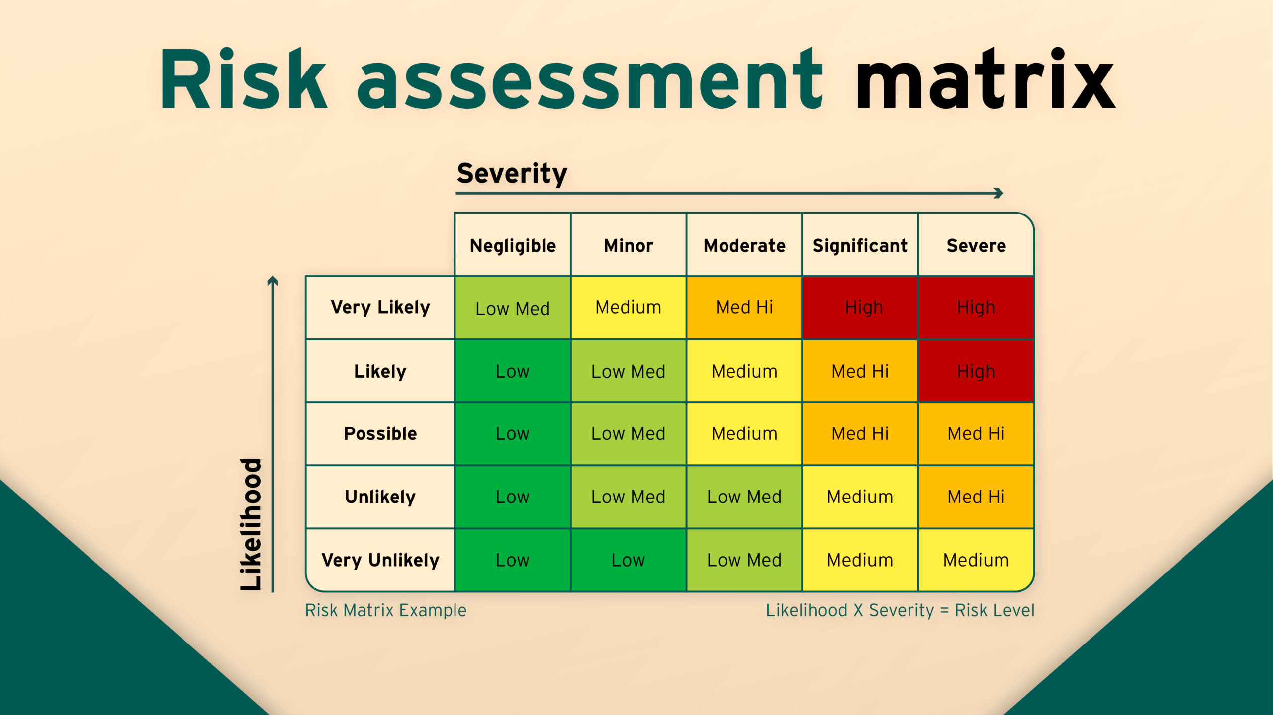
INFORMATION SECURITY – RISK ASSESSMENT (6/7)
Risk Assessment Matrix:

Slide 25
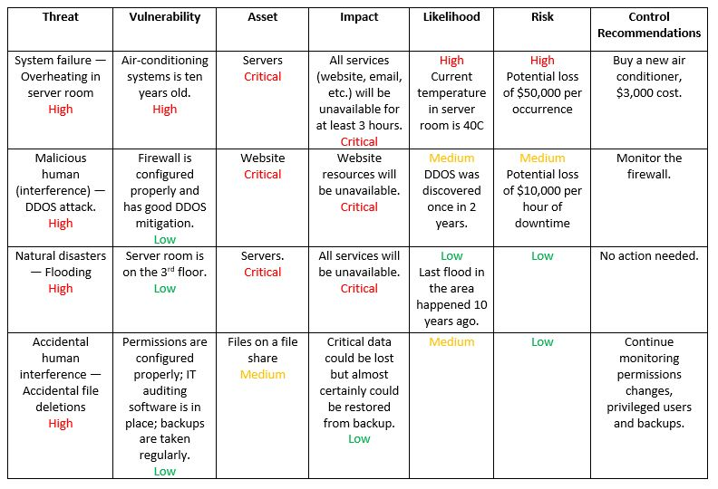
INFORMATION SECURITY – RISK ASSESSMENT (7/7)
Risk Assessment Report: The final step of the risk assessment process is to create a comprehensive report that aids management in making informed decisions on budget, policies, procedures and more. The report should delineate each threat, associated vulnerabilities, at-risk assets, potential impact on your IT infrastructure, probability of occurrence, and recommended control measures and cost.

Slide 26
Digital Forensics

Slide 27
Digital Forensics
Digital evidence features in just about every part of our personal and business lives. Legal and business decisions hinge on having timely data about what people have actually done. We generally performed Network based forensics, Computer Forensics, Mobile Forensics, Email Forensics, and Database Forensics.
MOBILE | Physical | Logical / Live Analysis | File System
 | Bit-by-Bit imaging of the mobile/tablet device | Active Content (User accessible) | Active content with application/tool support
 | Includes deleted data | Does not includes deleted data | Partially recovers deleted data
 | Captures call logs, SMS, mails, Application data, gallery, videos | Captures active content i.e. (contacts, call logs, images, videos) | Capture contacts, call logs, images, application data, videos)
SYSTEM | Bit-by-Bit imaging of the disk | Active Content (User accessible) | Active content with application/tool support
 | Includes deleted data from the FAT/NTFS file system | Includes deleted data partially from the file systems | Partially recover data
 | Capture deleted/formatted file of maximum file size of 4 G.B | Capture deleted files from the system and needs to perform on the live system that requires forensic software installation(s) on the suspected system. | Capture deleted files from the system and needs to perform on the connected/disconnected system that requires forensic software installation(s) on the suspected system.
DATABASE | Include recovery of the backup database file i.e. (MDF, LDF, ACCDB, MDB) | Capturing of DML queries such as (SELECT, UPDATE, DELETE, INSERT) triggered on the system. | N/A
 | Recover database i.e. of 6-8 GB of file size | Does not recover deleted data from the database | N/A

Slide 28
Digital Forensics - Approach
Processes that involved while performing the Digital forensics investigation using virtual security forensics evaluation methodology which can be defined as:
Identification
Determine the type of incident occurred in an organization in term of digital identification of the system(s) and the devices
Preservation
Perform the initial steps to fill the Chain of Custody form which includes key personnel name, sign & date/time while taking the device in custody.
Collection
Perform the Imaging of the devices which includes (Master & Working Copies) that are tagged with unique serial numbers and hashes
Analysis
Examine the data which is deleted/ formatted and perform keyword based searching
for potential evidences
Reporting
The report contains the factual findings, summary of evidences, tools used during the assessment and a testimony
Virtual security follows an international standard which were globally accepted in the field of digital Forensic is ISO/IEC 27037:2012 (Information technology — Guidelines for identification, collection, acquisition, and preservation of digital evidence). This standard provides guidance on identifying, gathering/collecting/acquiring, handling and protecting/preserving digital forensic evidence i.e. “digital data that may be of evidential value” for use in court of law.

Slide 29
Manage Digital Forensics –
Digital forensic management involves overseeing and coordinating digital forensic investigations to ensure efficiency, accuracy, and adherence to legal and organizational.
Key Components of Digital Forensic Management:
Case Intake: Receiving and prioritizing requests for digital forensic analysis, assessing the scope and requirements of each case.
Resource Allocation: Allocating personnel, tools, and equipment based on the complexity and urgency of investigations.
Case Management: Establishing protocols for case documentation, evidence handling, and chain of custody to maintain integrity and accountability.
Timely Response: Implementing procedures for timely response and resolution of digital forensic requests to minimize impact and mitigate risks.
Collaboration: Facilitating collaboration between digital forensic analysts, law enforcement agencies, legal teams, and other stakeholders involved in investigations.

Slide 30
Manage Digital Forensics –
Best Practices in Digital Forensic Management:
Standard Operating Procedures (SOPs): Developing and implementing SOPs for consistent and standardized digital forensic processes, ensuring quality and reliability of investigations.
Training and Development: Providing ongoing training and professional development opportunities for digital forensic personnel to enhance skills, knowledge, and proficiency in emerging technologies and methodologies.
Technology Integration: Leveraging advanced digital forensic tools, software, and technologies to streamline processes, automate tasks, and improve efficiency and effectiveness.
Quality Assurance: Implementing quality assurance measures, such as peer reviews, audits, and validation checks, to verify the accuracy and reliability of findings and reports.
Continuous Improvement: Encouraging feedback, evaluating performance metrics, and identifying areas for improvement to enhance the overall effectiveness and efficiency of digital forensic operations.

Slide 31
Manage Digital Forensics –
Challenges in Digital Forensic Management:
Resource Constraints: Limited budgets, staffing shortages, and access to specialized equipment and tools may pose challenges in managing digital forensic investigations effectively.
Legal and Regulatory Compliance: Navigating complex legal and regulatory frameworks, including privacy laws, evidence rules, and jurisdictional requirements, can be challenging and require careful consideration.
Technology Complexity: Rapid advancements in technology, encryption, and digital devices present challenges in keeping pace with evolving forensic techniques and tools.
Case Backlogs: High caseloads, resource limitations, and the complexity of digital investigations may lead to case backlogs and delays in resolving cases, impacting operational efficiency and responsiveness.
Data Volume and Diversity: Managing large volumes of digital data, diverse data sources, and complex data formats require robust storage, processing, and analysis capabilities to extract actionable insights effectively.

Slide 32
Digital Forensics – use cases & list of tools
Data Recovery:
  Scenario: A company's critical data has been accidentally deleted or lost due to a cyber attack.
  Tools:
    EnCase Forensic
    FTK (Forensic Toolkit)
    Recuva
    Sleuth Kit
Malware Analysis:
  Scenario: Investigating the behavior, origins, and impact of a malware infection on a computer system.
  Tools:
    IDA Pro
    OllyDbg
    Wireshark
    VirusTotal
Network Forensics:
  Scenario: Analyzing network traffic to identify unauthorized access, data breaches, or suspicious activities.
  Tools:
    Wireshark
    tcpdump
    NetworkMiner

Slide 33
Digital Forensics – use cases & list of tools
Mobile Device Forensics:
  Scenario: Extracting data from smartphones or tablets for investigations related to cybercrimes, thefts, or corporate espionage.
  Tools:
    Cellebrite UFED
    Oxygen Forensic Detective
    XRY
    Magnet AXIOM
Memory Forensics:
  Scenario: Investigating volatile memory (RAM) to identify running processes, open network connections, and malware artifacts.
  Tools:
    Volatility Framework
    Rekall
    Mandiant Redline
    WinDbg
Email Forensics:
  Scenario: Analyzing email headers, content, and attachments to trace the origin of malicious emails, phishing attempts, or corporate espionage.
  Tools:
    Email Examiner
    MailXaminer
    OutlookForensicsTool

Slide 34
Digital Forensics – use cases & list of tools
Database Forensics:
Scenario: Investigating unauthorized access, data manipulation, or data theft from databases.
Tools:
  DBMS Forensic Tool
  DataVeil
  Database Forensic Analyzer
  Sqlite Forensic Browser

Slide 35
Digital Forensics – Scope
The scope of digital forensics encompasses a wide range of activities and applications aimed at investigating, analyzing, and interpreting digital evidence for legal or investigative purposes. Here's a comprehensive overview of the scope of digital forensics:
Investigation of Cybercrimes:
  Digital forensics is crucial in investigating various cybercrimes such as hacking, data breaches, malware attacks, identity theft, online fraud, and cyberstalking. It involves analyzing digital evidence to identify perpetrators, their methods, and motives.
Incident Response:
  Digital forensics plays a vital role in incident response by collecting and analyzing evidence to understand the extent of security incidents, mitigate ongoing threats, and prevent future occurrences. It helps organizations identify vulnerabilities, patch security flaws, and improve cybersecurity posture.
Legal and Law Enforcement Support:
  Digital forensic evidence is often used in legal proceedings to support criminal investigations, prosecutions, and litigation. It helps law enforcement agencies and legal professionals establish facts, corroborate testimonies, and ensure the integrity of evidence presented in court.

Slide 36
Digital Forensics – Scope
Corporate Investigations:
  Digital forensics is employed by businesses and organizations to investigate internal incidents such as employee misconduct, intellectual property theft, data breaches, and compliance violations. It helps organizations protect their assets, maintain regulatory compliance, and uphold ethical standards.
Data Recovery:
  Digital forensics techniques are utilized to recover lost, deleted, or corrupted data from storage devices such as hard drives, USB drives, memory cards, and mobile devices. Data recovery is essential in both criminal investigations and business continuity efforts.
Network Security Monitoring:
  Digital forensics tools and methodologies are used for continuous monitoring of network traffic, detecting anomalous behavior, and identifying potential security breaches. It helps organizations detect and respond to cyber threats in real-time, enhancing overall network security.
Malware Analysis:
  Digital forensics experts analyze malicious software (malware) to understand its behavior, functionality, and impact on compromised systems. Malware analysis aids in developing effective countermeasures, improving antivirus detection capabilities, and attributing attacks to specific threat actors.

Slide 37
Digital Forensics – Scope
Mobile Device Forensics:
  With the widespread use of smartphones and tablets, digital forensics extends to the investigation of mobile devices to extract and analyze data relevant to criminal investigations, corporate espionage, or civil litigation. Mobile device forensics involves extracting call logs, text messages, emails, social media interactions, and location data.
Cloud Forensics:
  As more data is stored in cloud environments, digital forensics has expanded to include the investigation of cloud-based services and platforms. Cloud forensics involves analyzing data stored in cloud repositories, identifying security incidents, and preserving evidence in compliance with legal and regulatory requirements.
Research and Development:
  Digital forensics researchers continually develop new tools, techniques, and methodologies to address emerging threats, technological advancements, and evolving legal requirements. Research in digital forensics contributes to advancements in cybersecurity, law enforcement practices, and forensic science as a whole.

Slide 38
Digital Forensics – File Systems
Windows File Systems:
NTFS (New Technology File System):
  Widely used in modern Windows operating systems.
  Features advanced security, compression, and encryption capabilities.
  Analysis involves examining file attributes, MFT (Master File Table), and journaling.
FAT (File Allocation Table):
  Legacy file system used in older versions of Windows.
  Simple structure but lacks advanced features like NTFS.
  Analysis focuses on file allocation tables and directory structures.
exFAT (Extended File Allocation Table):
  Designed for flash drives and external storage devices.
  Supports larger file sizes and storage capacities compared to FAT.
  Analysis includes examining directory entries, allocation bitmaps, and timestamps.
Analysis Methods and Tools:
  Tools such as Autopsy, FTK (Forensic Toolkit), and X-Ways Forensics are commonly used for analyzing Windows file systems.
  Methods involve file system structure analysis, metadata examination, and file carving to recover deleted or hidden data.

Slide 39
Digital Forensics – File Systems
Linux/Unix File Systems:
Ext2, Ext3, Ext4 (Extended File System):
  Standard file systems for Linux distributions.
  Ext4 is the latest iteration, offering improvements in performance and scalability.
  Analysis involves examining inode structures, block allocation, and journaling.
XFS (X File System):
  High-performance file system commonly used in Linux environments.
  Optimized for large file sizes and high throughput.
  Analysis includes investigating metadata structures, journal logs, and directory hierarchies.
ReiserFS:
  Another Linux file system known for its journaling and metadata handling.
  Provides efficient storage allocation and recovery mechanisms.
  Analysis methods involve parsing B*-trees, journal analysis, and metadata examination.
Analysis Methods and Tools:
  Digital forensics tools such as Sleuth Kit, dd, and EnCase Forensic support analysis of Linux/Unix file systems.
  Methods encompass examining file system structures, recovering deleted files, and reconstructing file paths for investigative purposes.

Slide 40

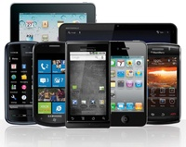
Digital Forensics – Coverage of digital assets
Hard Disk Drives (HDD):
Primary storage devices in computers and servers.
Store vast amounts of data, including operating systems, applications, documents, and user files.
Crucial focus of digital forensic investigations due to the wealth of potential evidence they contain.
Analysis involves examining file systems, metadata, and file contents for evidence of illegal activities or unauthorized access.
Mobile Devices:
Smartphones and tablets are ubiquitous and store diverse data types.
Contains call logs, text messages, emails, photos, videos, social media interactions, and application data.
Mobile forensics involves extracting and analyzing data from these devices using specialized tools and techniques.
Investigations often include recovering deleted data, examining communication records, and identifying location information.

Slide 41
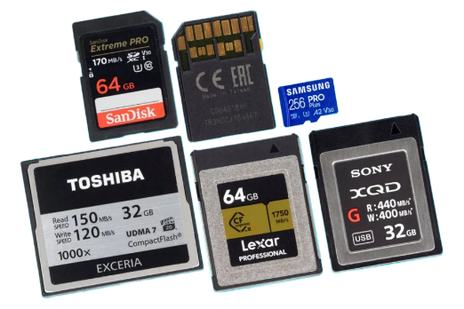
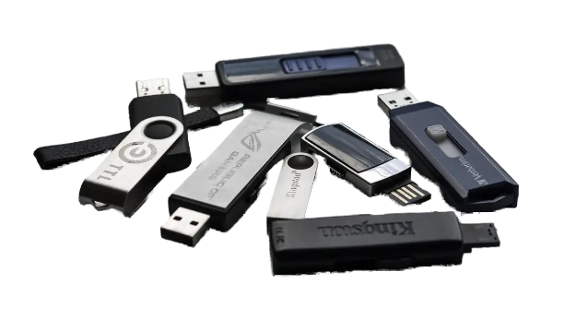
Digital Forensics – Coverage of digital assets
Memory Cards:
Used in digital cameras, smartphones, and other devices to expand storage capacity.
Store media files like photos, videos, audio recordings, as well as documents and application data.
Memory card forensics involves extracting and analyzing data to uncover evidence relevant to investigations.
Techniques include file carving, metadata analysis, and recovering deleted files.
USB Drives:
Portable storage devices for data transfer and storage.
Commonly used for carrying sensitive information, such as documents, presentations, and personal files.
USB drive forensics involves analyzing the contents to identify evidence of unauthorized access, data theft, or malware infections.
Examination may include file system analysis, timeline reconstruction, and metadata examination.

Slide 42
Digital Forensics – Network Forensic
Understanding Network Forensics:
  Network forensics involves monitoring and analyzing network traffic to detect security incidents, investigate breaches, and gather evidence for legal purposes.
Evaluating Data for Monitoring:
  Identify Threat Signatures: Network forensics aids in identifying known threat signatures, such as malware communication patterns, command and control traffic, or data exfiltration attempts.
  Detect Anomalies: Monitoring network traffic allows for the detection of anomalous behavior, such as unusual spikes in data transfer, unauthorized access attempts, or network reconnaissance activities.
  Analyze Access Logs: Examination of access logs from network devices, servers, and applications provides insights into user activities, authentication attempts, and potential security breaches.
  Monitor DNS Traffic: Monitoring DNS queries helps identify suspicious domain name resolutions, potential DNS tunneling, or connections to malicious domains associated with phishing or malware distribution.

Slide 43
Digital Forensics – Network Forensic
Utilizing Specialized Tools:
  Wireshark: Powerful network protocol analyzer for capturing and analyzing network packets, providing deep insights into network communication and identifying suspicious patterns.
  Intrusion Detection Systems (IDS): Deploying IDS solutions such as Snort or Suricata enables real-time detection of network-based attacks, generating alerts for further investigation.
  SIEM Integration: Integrating network forensic data with Security Information and Event Management (SIEM) systems enhances monitoring capabilities, enabling correlation of network events with other security data sources for comprehensive threat detection.
Benefits of Network Forensics:
  Early Threat Detection: Network forensics facilitates early detection of security threats, allowing organizations to respond proactively and mitigate risks before they escalate.
  Evidence Collection: Enables the collection of digital evidence necessary for incident response, forensic investigations, and legal proceedings, ensuring accountability and supporting regulatory compliance.
  Improved Incident Response: By providing detailed insights into network activities, network forensics enhances incident response capabilities, enabling swift and effective resolution of security incidents.
  .

Slide 44
Digital Forensics –Recovery vs. Imaging
Recovery | Imaging
Recovery focuses on accessing specific data or files. | Imaging captures the entire contents of a storage device.
Recovery is used to retrieve specific evidence or data. | Imaging preserves the complete state of the storage device for forensic analysis.
Recovery may involve targeted data extraction techniques. | imaging requires creating a sector-by-sector copy of the storage device.
Recovery may involve modifying or accessing data directly. | Imaging ensures the forensic soundness of evidence by preserving its integrity.
  .

Slide 45
OT CYBER SECURITY SERVICES

Slide 46
ABOUT OT
Cyber security in operational environments requires an industrial mindset, extensive knowledge of operational technology (OT), and experience addressing cyber threats to processes, systems, and assets. Security Services from Virtual Security help organizations mitigate risk to their operations by hardening their attack surface, improving security awareness, and improving their security posture.
Operational environments are under increasing pressure from a growing threat environment, stringent compliance requirements, and growing demand for more efficient production. Advances in technology offer significant opportunities to reduce operational cost and improve efficiency. To capture that opportunity, organizations are rapidly integrating their operational technology (OT) with the broader, enterprise IT network to create a more agile, digital industry. In doing so, however, vulnerabilities in the OT landscape are exposed to new, sophisticated threats that pose significant risk to the entire enterprise.
While most organizations are adept at addressing IT network exposure, they often overlook the risk to their operations network. The unique nature of the OT network and the threats that put it at risk require specific skills, expertise, and experience that are lagging or absent in the IT security organization. As a result, organizations are struggling to ensure their operational technology is cyber-ready.
To securely adapt to the digital world, industrial companies must plan, design and deploy operational security measures across their people, processes and technology and Virtual Security insures you to provide best services.

Slide 47
VENDOR BASED ASSESSMENTS (1/3)
Assessing cybersecurity for Operational Technology (OT) vendors is a crucial part of ensuring the security and reliability of OT systems and processes. The specific criteria for evaluating OT vendors can vary based on the industry, specific technologies, and the criticality of the systems involved. Here's a general list of OT vendors and some assessment criteria:
Industrial Control System (ICS) and SCADA Vendors:
Secure Coding Practices: Evaluate if the vendor follows secure coding practices to minimize vulnerabilities.
Patch Management: Assess the vendor's process for delivering and applying security patches.
Vulnerability Disclosure: Check if the vendor has a responsible disclosure process for security researchers.
Authentication and Authorization: Evaluate the strength of authentication and authorization mechanisms in the vendor's products.
Encryption: Ensure that data in transit and at rest is properly encrypted.
Secure Configuration: Assess if the vendor's products come with secure default configurations.
Compliance with Standards: Ensure that the vendor's products comply with industry standards (e.g., ISA/IEC 62443).
Incident Response Support: Check if the vendor provides guidance and support in the event of a security incident.
PLC (Programmable Logic Controller) and RTU (Remote Terminal Unit) Vendors:
Integrity and Authentication: Assess the ability to ensure the integrity and authenticity of control logic.
Firmware and Software Security: Evaluate how firmware and software updates are secured and validated.
Communication Security: Ensure secure communication protocols and encryption are in place.
Access Control: Assess the level of access control and user authentication.
Vendor Support and Patching: Evaluate the vendor's ability to provide timely patches and support.

Slide 48
VENDOR BASED ASSESSMENTS (2/3)
HMI (Human-Machine Interface) and MES (Manufacturing Execution System) Vendors:
User Authentication: Check the strength of user authentication mechanisms.
Audit Trails: Ensure that changes to configurations and data are logged for auditing purposes.
Secure Data Transfer: Assess how data is transferred between systems and devices.
Role-Based Access Control: Evaluate the granularity of access control and permissions.
Integration with Security Tools: Consider the vendor's ability to integrate with security monitoring tools.
IoT and IIoT Device Vendors:
Device Security: Assess the device's security features, including encryption and access control.
Firmware Update Mechanisms: Evaluate the process for updating device firmware securely.
Device Lifecycle Management: Check how end-of-life devices are managed.
Vendor's Supply Chain Security: Assess the security of the vendor's supply chain and manufacturing process.
Network and Security Appliance Vendors:
Firewall and Intrusion Detection/Prevention: Evaluate the effectiveness of firewall and intrusion detection/prevention features.
VPN and Secure Tunneling: Ensure secure communication options are available.
Vendor's Security Certifications: Check if the vendor's products have relevant certifications (e.g., Common Criteria).
Access Control System Vendors:
Authentication and Authorization: Assess user authentication and authorization features.
Integration with OT Systems: Evaluate the ability to integrate access control systems with other OT devices.
Physical Security: Check if the access control system includes physical security features, such as biometrics.

Slide 49
VENDOR BASED ASSESSMENTS (3/3)
Physical Security System Vendors:
Camera and Sensor Security: Assess the security of cameras and sensors in the system.
Data Encryption: Ensure that video and sensor data is encrypted in transit and at rest.
Integration with Other Security Systems: Evaluate how the physical security system integrates with other OT security systems.

Slide 50
OT CYBERSECURITY REVIEW
Virtual security has adapted an international approach for conducting an OT (Operational Technology) cybersecurity review is a comprehensive process that should be well-structured. The sequence of assessment can vary depending on the specific goals and the maturity of the organization's OT cybersecurity program. Here's a suggested sequence for conducting such a review:
Scope Definition:
Define the scope of the review, including the OT systems, assets, and networks to be assessed.
Identify the goals and objectives of the assessment.
Criticality Assessment:
Determine the criticality of the OT assets and systems. This includes assessing the impact on safety, production, and business operations if these assets were compromised.
Impact Assessment and Impact Matrix:
Assess the potential impacts of security incidents on the OT environment.
Create an impact matrix to categorize the severity and consequences of various incidents.
RASIC Matrix (Responsibility Assignment):
Define roles and responsibilities for individuals or teams involved in OT cybersecurity.
Assign responsibilities for risk management, incident response, and other relevant areas.
Threat Assessment:
Identify and assess potential threats to the OT environment. This can include both internal and external threats.
Analyze threat actors and their motivations.

Slide 51
OT CYBERSECURITY REVIEW
Virtual security has adapted an international approach for conducting an OT (Operational Technology) cybersecurity review is a comprehensive process that should be well-structured. The sequence of assessment can vary depending on the specific goals and the maturity of the organization's OT cybersecurity program. In order to conduct a comprehensive GAP assessment virtual security follows the below sequences wise assessment for conducting such a detailed review of OT systems:
Risk Assessment and Risk Matrix:
Evaluate the risks associated with identified threats.
Create a risk matrix that categorizes and prioritizes risks based on likelihood and impact.
Vulnerability Assessment:
Identify vulnerabilities within the OT systems, devices, and networks.
Evaluate the effectiveness of existing security controls and safeguards.
Foundational Requirements Assessment:
Assess the organization's compliance with foundational security requirements and standards, such as NIST Cybersecurity Framework, ISA/IEC 62443, NERC CIP, or industry-specific standards.
Gap Analysis:
Identify the gaps between the current state of OT security and best practices or compliance requirements.
Prioritize the gaps based on their potential impact.
Security Controls and Countermeasures:
Develop and recommend security controls and countermeasures to address identified risks and vulnerabilities.
Resilience and Recovery Planning:
Develop or review incident response and recovery plans for OT environments.
Ensure the organization is prepared to respond to and recover from security incidents.

Slide 52
OT CYBERSECURITY REVIEW
Testing and Validation:
Conduct penetration testing, vulnerability scanning, or security assessments to validate the effectiveness of security controls.
Documentation and Reporting:
Compile all assessment findings, recommendations, and action plans into a comprehensive report.
Provide executive summaries and detailed technical reports as needed.
Action Plan and Remediation:
Develop a prioritized action plan to address identified gaps and risks.
Establish a timeline for implementing security improvements.
Continuous Monitoring:
Implement continuous monitoring processes to ensure ongoing visibility into the security posture of the OT environment.
Review and Update:
Review and update the cybersecurity program to adapt to changing threats and technologies.
Security Awareness and Training:
Assess the awareness and training programs for OT staff.
Ensure that employees are knowledgeable about cybersecurity best practices.

Slide 53
Managed soc
(Security operation center)

Slide 54









Managed soc security operation center
Virtual security Managed SOC services provide client an ease have a visibility about the as of and latest threats appeared on the network, With round the clock monitoring, we detect potential threats across your network, users and applications. Our security monitoring services include real-time alerting, event log monitoring, proactive hunting, compliance reporting and so forth.
Managed SOC Structure
Virtual Security offers detailed Managed SOC services to identify real-time attacks and threats detection. The assessment will specifically focused on the following area :
Identification and terminate real-time attacks;
Real-time threat detection and alerts notification;
Rules tuning & event correlation with different log sources;
24/7 or 8/5 monitoring options and analysis of alerts;
Helps in optimizing the solution and hands on support for high-priority incidents.
Expertise in Different Technologies

Slide 55



Managed soc - Approach
Virtual security Managed SOC services provide client an ease have a visibility about the as of and latest threats appeared on the network, With round the clock monitoring, we detect potential threats across your network, users and applications. Our security monitoring services include real-time alerting, event log monitoring, proactive hunting, compliance reporting and so forth.
Managed SOC Team Structure
SOC Manager - Managing resources to include personnel, budget, team shifts, scheduling, trainings strategy to meet SLA’s, Meeting with client management, provide overall status of the SOC and communicate critical incidents to the management.
Tier 2- Perform deep dive incident analysis correlating data from various sources; determines
If a critical system or data set has been impacted; advises on remediation; provide support for few new analytic methods for detecting threats.
Tier 1- Perform deep dive continuously monitors alert queue; triages security alerts; monitors health of security sensors and points; collect data and context necessary to initiate tiger 2 work.

Slide 56
Business Continuity & Disaster Recovery

Slide 57
Business Continuity & Disaster Recovery
Business continuity is all about planning & ensuring that all your critical business functions should be available to your customers, suppliers, regulators, and other entities even during emergencies, crisis and disaster situations. It refers to those activities performed daily to maintain service, consistency, and recoverability of your business.
Virtual Security helps organizations to establish, implement, maintain and monitor business continuity with its following services:
Business Impact Assessment (BIA)
Business Impact Assessment (or Business Impact Analysis) is an essential part of the business continuity planning process that helps a business to understand its financial and operational exposures in the event of an interruption. BIA identifies mission-critical areas and processes that are critical for the survival of business. BIA raises senior management’s awareness of undesirable consequences and potential operational risk, which helps to justify the need for a business continuity plan.
Virtual Security offers detailed Business Impact Assessment (BIA) services to identify mission-critical processes of your business. The assessment will specifically focused on the following area :
Identification of mission-critical areas and processes that are critical to the survival of business;
Maximum Tolerable Period of Disruption (MTPD) for critical processes;
Recovery Time Objective (RTO) and Recovery Point Objective (RPO) for business processes.
Our consultant helps in calculating the RTO & RPO as per business requirements depending upon the factors which business lies on i.e. (financial cost of the downtime, time to announce disaster, time to recover from disaster initiation of the recovery etc.)

Slide 58
Business Continuity & Disaster Recovery (Cont’d)…
Business Continuity Plan (BCP) Development
Having a detailed Business Continuity Plan is a basic requirement of having effective business continuity arrangements in your organization. This document actually outlines all those actions plans which the organizations and dedicated teams must take in the event of a disaster. Business continuity planning identifies an organization's exposure to internal and external threats and synthesizes hard and soft assets to provide effective prevention and recovery for the organization. Our Consultants utilize the results of the BIA to develop a customized Business Continuity plan for your organization which designed to allow your business to continue performing its critical business functions in the event of a disaster.
Such a plan minimizes the risk to continued business operations and increases your ability to quickly and effectively react to a disaster. You get a tailored Business Continuity Plan according to the needs of your business; you have all your business risks identified along with their treatment strategies and a complete Business Resumption Plan in case if any disaster hits your organization.

Slide 59
Business Continuity & Disaster Recovery (Cont’d)…
BCP Implementation and Testing
Even a well thought BCP is likely to fail if it is not tested and the assigned teams are not trained on how to utilize the action plans documented therein. Testing is the critical step in the Business Continuity Planning process. To help you in this task, Virtual Security offers implementation of the Business Continuity Plan validating that all of the resources required to maintain business continuity are in place and operational before any disaster strikes.
Our Consultants work hand-in-hand with your organization to test the BCP and to verify that you will be prepared to deal with situations that may impact the continued successful operation of your critical business functions. Through this testing, you gain a higher level of confidence on your developed BCP whereas organization-wide implementation of BCP, resulting into higher level of awareness.

Slide 60
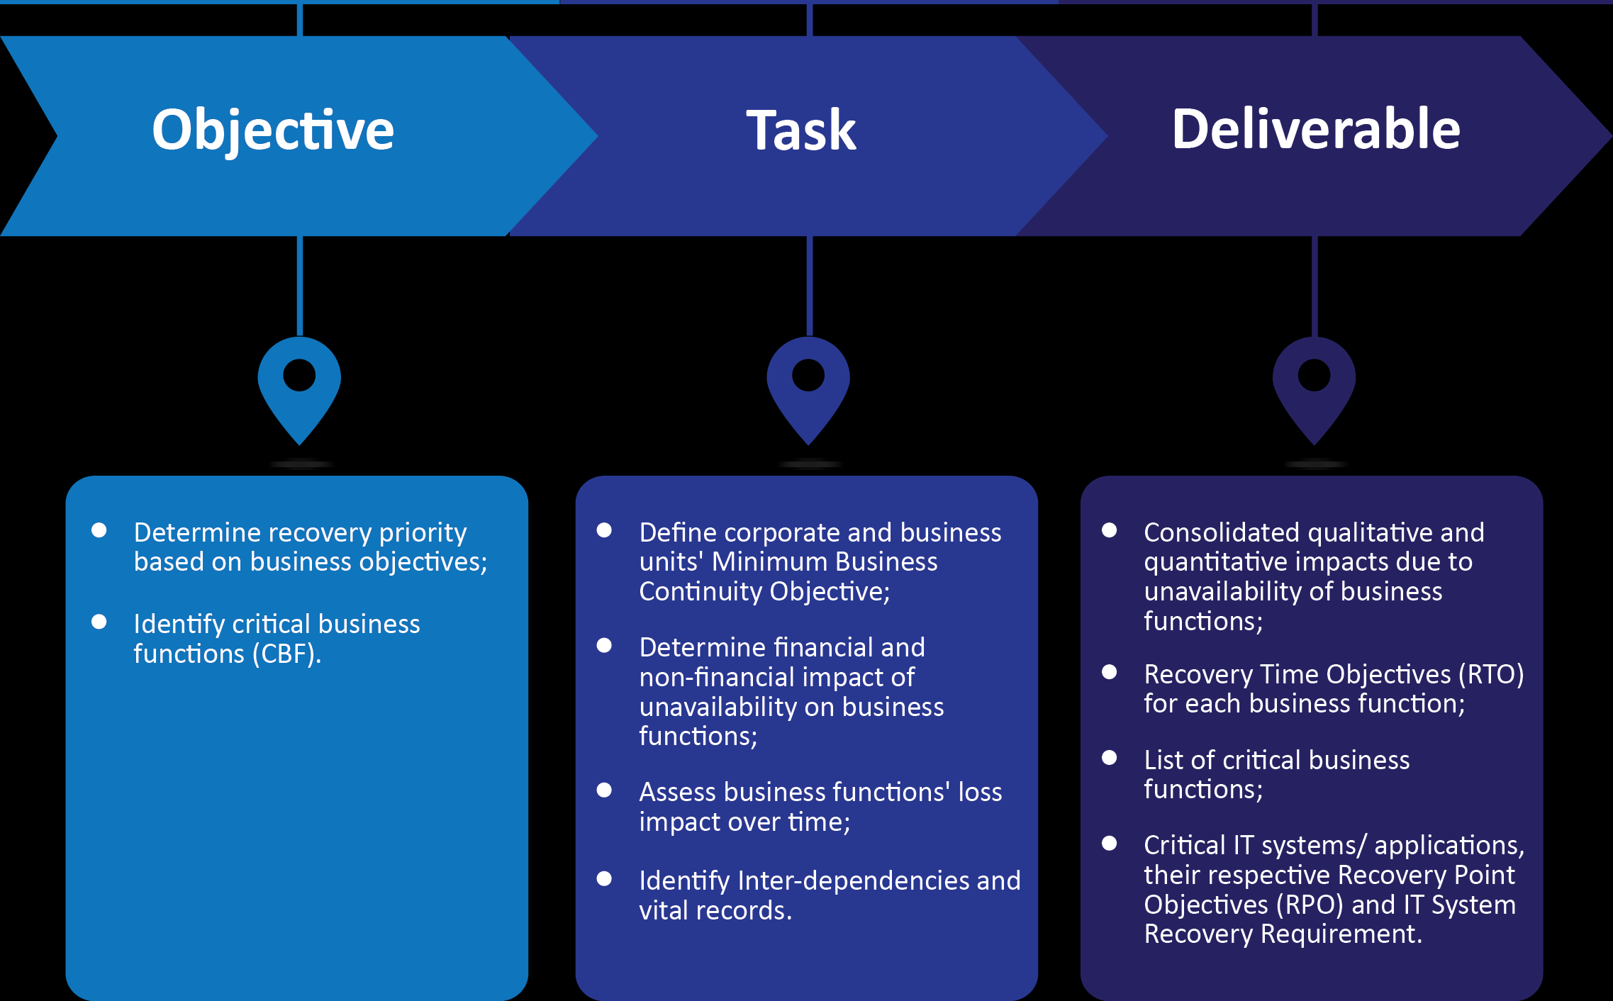
Business Impact Assessment - Approach
Virtual Security’s Global Cyber Security Framework
An integrated approach to addressing Cyber Threats

Slide 61
Cyber threat intelligence

Slide 62
Cyber threat intelligence
Security & Threat Intelligence Analysis
Cyber threat Intelligence is an open challenge for organization at medium and enterprise level, due to lack of training and weak processes organization(s) employee uploaded sensitive data on Free, temporary domains to accomplish their ongoing task, this information may become useful for the competitors and hackers to penetrate through different routes in the organization.
Our Consultants works for your organization to find detailed information about a host and the underlying infrastructure in seconds through the threat intelligence tools which are being desgined and developed by Virtual Security. There are multiple situations that may impact the continued successful operation of your critical business functions. In order to get organization aware from unwanted domains and information published over the internet resulting into higher level of breaches.
  While conducting a planned Cyber attack, attacker gathers the available information from social media, third party forums, search engines and websites (Shodan, bing, xforce, virus total), once they got the information they leaked the information on dark net.
  When information is collected (email addresses, Contact No) etc,. attacker send a fictitious link to the victim claiming to be from a legitimate source, once the victim click on the link their systems and OS got infected, Attacker interestingly steals accounts credentials, contact numbers, email addresses of other party, personal data) from the system.
  Threat intelligence in the current world of cyber must be required by organization keeping sensitive and critical data of the customers including (Banking & Financial institutions, Health care organizations, Government Entities, Public sectors, Educational Institutions),

Slide 63
Cyber threat intelligence - Approach
Cyber Threat Intelligence Analysis - Approach
Virtual security utilizes different techniques in order to retrieve the content of the domain and other related information from the internet. We have a unique verity and set of custom designed tool(s) which helps organization to present result in a very short span of time.
Following are the list of approaches which virtual security utilizes manually and through automated tools:
Google Dorking – Querying the domain/URL related information through different search engines (Bing, Google, AltaVista, DuckDuckgo, SHODAN, Yahoo, Achieve)etc.;
Scan Name Server(s) – Check name servers configurations;
Identify WHOIS Records – discover & identify the WHOIS records of unofficial domain/URLs;
Scan Mail Server Entries – Check MX records configuration and examine the mail servers;
Foot printing – Passive information gathering about the host from different dark webs in order to verify whether the domain is published on dark net/TOR servers;
Scan for Blacklisting – Assess blacklisting for domain entries over the internet.
DNS Resolver - Validate that reverse-resolved hostnames still resolve back to that IP before considering them as aliases of your target.

Slide 64
Cyber threat intelligence – Approach (cont’d)…
Metadata Analysis – Analyze File extensions of files to search meta data of (only PDF, DOCX, XLSX and PPTX are supported).
Historical data analysis - Number of days back to look for older versions of files/pages in the Way back Machine.
Third Party data analytics – assess how data is provided to the third parties including (Developers, Trouble shooting, designing and customizing organization websites/applications);

Slide 65
Cyber Drills

Slide 66
Cyber Drills
Enterprises have deployed multiple technologies and processes for detecting and responding to threats. Still when it comes to responding to real security incidents, many organizations fail to make the grade. Incident response strategies can fail if they are not well tested. Cyber security drills provide a way to test all elements of an effective incident detection and response strategy.
Cyber drills simulation runs through a scenario with each participating country divided into two roles:
A Player – The one who involved in simulating the cyber drill
An Observer – The one who observes that what is happing during the cyber drill process
Components | Deliverable
Simulated Cyber attacks scenarios | On site Cyber attack simulation exercise
Cyber Drill Infrastructure assessment | The overall assessment that identify the projected drill result carried out from the assessment
Evidences for incident analysis | Incident analysis and walkthroughs
Alert, notification and Reporting of a cyber attack | Communicate the attack and closure of the incident after recovery

Slide 67
Cyber Drills – Scenario based Simulation
Virtual security provides scenarios while performing cyber dill in an organization, to identify what security measures an organization has taken, the scenarios are developed to evaluate an human based error factor and also evaluate the performance encountered by an attack performed during the cyber drill:
Following are the list of example scenario which we execute normally in case of cyber drills, these scenario are quoted as an example there are numerous scenario which virtual security performs by taking key staff members of the organization in loop:
Drill Type | Scenario Executed
DOS/DDOS Attack | Perform DDOS attack on the organization target system(s) and analyze how an incident is being handled by the Security & IT Teams
Social Engineering | To send Malicious email to the targeted user to the organization claiming to be an authentic email of Change password of windows login due to multiple failed attempts done by the user
Compromising Mobile Devices | Publishing a rouge WIFI and giving free access to the users in the organization, the free WIFI requirements are to update and install a program in the mobile phone in order to enhance the bandwidth
Combinations and Parameterized based attack on the system | Identify and execute multiple types of Brute force, Dictionary, Blind/Error based SQL injection, Code injection attack against the identified critical system and monitor how the countermeasures has been taken in order isolate from a Cyber Attack.

Slide 68
Cyber Drills – FORMAT AND SCENARIOS
Virtual security provides scenarios while performing cyber dill in an organization, to identify what security measures an organization has taken, the scenarios are developed to evaluate an human based error factor and also evaluate the performance encountered by an attack performed during the cyber drill:
Step 1: Introduction (30 minutes)
Welcoming all participants.
Provide an overview of the exercise, its goals, and the importance of incident response preparedness.
Explain that this is a simulation and not a real incident.
Describe the scenario: "Your organization has fallen victim to a Ransomware Attack. Critical data has been encrypted, and a ransom demand has been received.“
Step 2: Scenario Unfolding (60 minutes)
Present the incident details step by step, providing information as if the incident were happening in real-time.
Begin with the initial incident report, including a description of the attack vector and initial observations.
Allow participants to ask questions and gather information as if they were in the early stages of responding to a real incident.
Provide periodic updates and new developments in the scenario.
Step 3: Response Phase (90 minutes)
Participants enact their roles and respond to the incident:
Information Security, IT, and Legal teams collaborate to contain, investigate, and respond to the incident.
Communication and PR teams draft a fictional press release and plan for internal and external communication.
Executive management makes decisions regarding escalation, resource allocation, and communication strategies

Slide 69
Cyber Drills – FORMAT AND SCENARIOS
Step 4: Discussion and Analysis (60 minutes)
Reconvene participants in a group discussion.
Each team presents its actions, decisions, and rationale.
Facilitate discussions on what went well, what could have been done differently, and lessons learned.
Encourage open and constructive feedback among participants.
Step 5: After-Action Report (30 minutes)
Summarize the exercise outcomes, highlighting key takeaways and lessons learned.
Document action items and recommendations for improving incident response procedures, policies, and communication strategies.
Step 6: Closure (15 minutes)
Thank participants for their active involvement and contributions.
Emphasize the importance of continuous training and preparedness.
Share next steps, including follow-up training and future tabletop exercises.
Post-Exercise Actions:
Compile the after-action report, including action items and recommendations.
Develop a plan to address identified weaknesses and improve incident response procedures.
Schedule follow-up training sessions and exercises based on the lessons learned.
Share the exercise outcomes and lessons with the broader organization to raise awareness of cybersecurity risks and preparedness.
Maintain a schedule of regular tabletop exercises to ensure continuous improvement and readiness.

Slide 70
IT Due Diligence

Slide 71
IT DUE Diligence
Virtual security has a dedicated team for conducting due diligence activity for an organization, the assessment includes but not limited to (Identify, evaluate, assess, analyze and verify all the available information of an individual or an organization in order to better understand an organization.
To conduct a due diligence when organization are in the phase of merger, acquisition, development, new investment plans, consortium. Company needs to assure that there is no outstanding litigation, judgments, liens, or other legal issues that can complicate or prolong the phase as mentioned above.
Following are the list of preliminary checks which virtual security initially perform through manual and automated approaches.
Source of Information | Description
Assessment through Internet on general information sites | Internet searches including but not limited to the following: Company Website Reverse Address Lookup Search organization on Corruption monitoring websites Search records on Social Network (Facebook, Twitter);
Black listing of individual/organization & reputation assessment | By performing a social statistics analysis to obtain the reputation of the organization and assess the organizational websites, portals, applications for blacklisting over the internet.
Verification of Government documents/ Educational credentials of Employees | Verification of government documents (including certificates, NTN, Tax registration, Company presence) and conduct through assessment of educational credentials including (University Degree verification, Global / International Certification verification)
Media reports and Public records available on Internet | The assessment will check any investigation or allegations are being faced y the individual or an organization.

Slide 72
IT DUE Diligence - Approach
Explore
Assess
Analyze
Report
Perform Searches Over the Internet
Gather and Collect as much information as required
Analyze the data collected from the Information sources
Report all the identified issues against the organization / individuals
The approach for assessing an organization or an individual based on the following criteria which virtual security search and discover through their customized solutions and manual checks:
Customized Searches Name & Owner of Business Owner Political Involvement Civil Litigation Check Media Check Federal Criminal Check Employment References Country Specific Risk Warning List of Financial Regulators / Governing bodies Debarred companies and Disqualified list of Senior employee | Crime check Due Diligence Company Vehicle(s) Verification. Professional License Verification Federal Bankruptcy DBR & Mortgagors check Loan Check Search for Wanted Persons | Technical Due Diligence Review of application ­Review IT Organization Structure Assessment of technology teams roles and responsibilities ­Assessment of existing in scope applications and its operations Review of applications functionalities based on best practice Mapping of existing Functionalities (if provided by client) Development and implementation methodology and approach Review development approach and technology architecture Tools used in development, QA and testing processes Assessment of Communication Channels Assessment of Web Services (API’s) Static & Dynamic Source Code Analysis

Slide 73
Compromise assessment

Slide 74

Compromise Assessment
Virtual security specifically focuses to identify previously unknown, successful or ongoing compromises,. To achieve this our approach for identifying such attacks is slightly different from the general approach which normally different organizations are adopting.
To conduct a compromise assessment against (Mobile, Laptops, Desktops, Servers, Network Equipment) etc. we follow the following procedure in order to conduct a compromise assessment successfully
Pre & post
assessment
Target Device
Compromise Assessment
Reporting on the Compromises

Slide 75
Compromise Assessment - Approach
Application Analysis
Application Behavior Analysis
Malware assessment against applications
Application links and references assessment
Network Behaviour Analysis
Identification of Malicious artefacts
Unnecessary open Connections
Unnecessary open Connections
Unauthorized External Connections
Illegitimate External Connections
Network Performance Analysis
Network Performance Analysis
Bandwidth analysis
Live System Assessment
Identification of Anomalies
System Behavior Analysis
Assessment for Suspicious Activities
Host Based Analysis
Automated Connection request creation & termination
Discovery of Malicious Software's
Open ports Analysis
Reporting
Blocking & Preventing External Attacks
Pre-incident Reporting AS-OF Status
Blocking unnecessary connection requests
Reporting the Discovered Findings
Disconnecting the connected IP Addresses over the network.

Slide 76
Cyber Security
Readiness & Maturity Assessment

Slide 77
Cyber Drills – Threat Management (Cont’d…)
 |  |  |  | Security awareness & training of cyber threats
 |  |  | Basic online brand monitoring | Online brand & social media policing | Brand monitoring
 |  | Ad Hoc system/malware analysis | Automated malware forensics & Manual electronic Discovery | Automated electronic discovery & forensics | E-Discovery & Forensics analysis
 |  | Ad Hoc threat intelligence sharing with peers | Government sector threat intelligence collaboration | Global cross sector threat intelligence | Intelligence collaboration
 |  | Commercial & open source threat intelligence | Criminal / Hacker Surveillance | Baiting & counter intelligence | External threat intelligence
 |  | Network & System centric activity profiling | Work force / customer behavior profiling | Real time business risk analytics & detection support | Behavior analytics
 | Acceptable Usage policy | General information security training & awareness | Targeted intelligence based cyber security awareness | Business partner cyber security awareness | Training & awareness
 | IT BC & DR Exercise | IT Cyber attacks simulations | Business Wide cyber attack exercise | Sector wide & supply chain cyber attack exercise | Cyber attack Preparation
Basic network Protection | AD Hoc Infrastructure & network assessment | Enterprise wide infrastructure & network protection | Identify – aware information protection | Adaptive & automated security controls updates | Asset Protection
IT Service desk & Whistle blowing | Internal systems Security event Monitoring | Enterprise Technology based centric reporting | External & internal threat intelligence | Cross channel integrated activity detection | Security event monitoring
Traditional Signature based security controls | Periodic IT Asset Vulnerability Assessment | Automated IT Asset & Vulnerability Monitoring | Targeted cross-platform user activity monitoring | Tailored & Integrated business process monitoring | Internal threat intelligence
Cyber Maturity Levels
Level 1 | Level 2 | Level 3 | Level 4 | Level 5

Slide 78
PCI DSS readiness assessment

Slide 79
PCI DSS readiness assessment
Introduction to PCI DSS
PCI security standards are technical and operational requirements set by the PCI Security Standards Council (PCI SSC) to protect cardholder data.
The standards apply to all organizations that store, process or transmit cardholder data – with guidance for software developers and manufacturers of applications and devices used in those transactions.
The PCI DSS is a multifaceted security standard that includes requirements for the following areas:
– Patch Management
– Security management
– Policies, procedures;
– Network architecture;
– Software design and
– Other critical protective measures.
This comprehensive standard is intended to help organizations proactively protect customer account data.
The PCI Security Standards Council will enhance the PCI DSS as needed to ensure that the standard includes any new or modified requirements necessary to mitigate emerging payment security risks, while continuing to foster wide-scale adoption..

Slide 80
PCI DSS readiness assessment – Approach
PCI DSS COMPLIANCE & CONTROL REQUIREMENTS | Build and Maintain a Secure Network
 | Requirement 1 Requirement 2 | Install and maintain a firewall configuration to protect cardholder data Do not use vendor-supplied defaults for system passwords and other security parameters
 | Protect Cardholder Data
 | Requirement 3 Requirement 4 | Protect stored cardholder data Encrypt transmission of cardholder data across open, public networks
 | Maintain a Vulnerability Management Program
 | Requirement 5 Requirement 6 | Use and regularly update anti-virus software Develop and maintain secure systems and applications
 | Implement Strong Access Control Measures
 | Requirement 7 Requirement 8 Requirement 9 | Restrict access to cardholder data by business need-to-know Assign a unique ID to each person with computer access Restrict physical access to cardholder data
 | Regularly Monitor and Test Networks
 | Requirement 10 Requirement 11 | Track and monitor all access to network resources and cardholder data Regularly test security systems and processes
 | Maintain an Information Security Policy
 | Requirement 12 | Maintain a policy that addresses information security

Slide 81
PCI DSS readiness assessment - METHODOLOGY
Gap Analysis & Scanning
A gap analysis is performed against current and applicable PCI DSS. Scanning using the same tools as ASV.
QSA / ASV audit
A third-party QSA or ASV performs the audit. We assists the client by helping the client to prepare necessary documentation for the third-party auditor as well as supporting the client in discussions with the auditor.
Approach definition
Together with the client, gap closure approach is agreed. Common PCI compliance approaches include but not limited to:
Card Processing Environment
Ensure End to End Encryption
Tokenization
Risk Mitigation
Complete Review of card processing environment
Remediation
All card payment information flows and processes are identified. Processing systems are enumerated.
Based on the previously selected approach, remediation activities are carried out. We help the client by providing mitigation advice and technical guidance

Slide 82
List of Licensed / Open Source Tools

Slide 83
List of Licensed / Open Source Tools - Secure Web Review
While reviewing a website we will be utilizing multiple Licensed / Open source Tools in order to prepare website in a secure channel. Keeping a client perspective in mind to developed and designed a website which can run upto next 3 years without any trouble.
Name of Tool(s) | Tool Type | Tool Description
Microsoft Visual Studio | Licensed | Visual Studio Code is a code editor redefined and optimized for building and debugging modern web and cloud applications.
Dreamweaver | Licensed | Dreamweaver gives you faster, easier ways to design, code, and publish websites and web applications that look amazing on any size screen.
Jet brains | Licensed | Jet Brains is a cutting-edge software vendor specializing in the creation of intelligent development tools, including IntelliJ IDEA – the leading Java IDE.
PHP Designer | Open Source | phpDesigner is a lightning fast and powerful PHP IDE and PHP editor boosted with all the features to help you create amazing websites.
Script case | Open Source | An efficient web development low-code platform. It helps you to create complete web systems and Business Intelligence solutions fast and easy.
GIMP | Open Source | GIMP is a multi-platform photo manipulation tool. GIMP is an acronym for GNU Image Manipulation Program.
Word Press | Open Source | WordPress (WordPress.org) is a free and open-source content management system (CMS) based on PHP & MySQL.
Joomla | Open Source | Joomla! is a free and open-source content management system for publishing web content, developed by Open Source Matters, Inc. It is built on a model–view–controller web application framework that can be used independently of the CMS.

Slide 84
List of Licensed / Open Source Tools – Vulnerability assessment & pentest
While conducting a web based security assessment, the phase starts from Discovering the domains, public IP Addresses and dedicated IP Addresses, for this following are the list of tools which helps while conducting a web based assessment.
Name of Tool(s) | Tool Type | Tool Description
Accunetix | Licensed | Virtual Security is an authorized distributor and partner of accunetix vulnerability scanner tool in Pakistan.
Net Sparker | Licensed | Netsparker is a web application security scanner, with support for both detection and exploitation of vulnerabilities
Burp Suite | Licensed | Burp Suite is a Java based Web Penetration Testing framework. ... Burp Suite helps you identify vulnerabilities and verify attack vectors that are affecting web applications
OWASP ZAP | Open Source | OWASP ZAP is an open-source web application security scanner. It is intended to be used by both those new to application security as well as professional penetration testers.
Nikto | Open Source | Nikto allows penetration testers and ethical hackers to perform a full web server scan to discover security flaws and vulnerabilities. This security scan gathers results by detecting insecure file and app patterns, outdated server software and default file names as well as server and software misconfigurations.
OpenVAS | Open Source | The tool allows you to write and integrate your own security plugins to the OpenVAS platform.

Slide 85
List of Licensed / Open Source Tools – Mobile application security
While conducting a Mobile Application security assessment, the phase starts from Discovering the identifying a mobile application and its presence, reversing, Assessing the application by examine OWASP Mobile TOP 10, for this following are the list of tools which helps while conducting a Mobile Application Security assessment.
Name of Tool(s) | Tool Type | Tool Description
Dex2Jar | Open Source | A collection of tools and libraries that can work with Android .dex and java .class files in order to help programmers to streamline the development process.
JDGUI | Open source | Tool used to decompile the java application(s) code and reduce time.
Burp Suite | Licensed | Burp Suite is a Java based Web Penetration Testing framework. ... Burp Suite helps you identify vulnerabilities and verify attack vectors that are affecting web applications
App Cloner | Licensed | App Cloner premium used to check the application (backward compatibility, supporting on different platforms, and assess the application cloning capabilities of the original application)
Cain n Abel | Open Source | Tool has ability to capture network packet, perform sniffing, cracking various password hashes by using methods such as dictionary attacks, brute force and cryptanalysis attacks.
Codified Security | Licensed | Codified Security is a best in class automated testing platform that detects ... static analysis tool, solving the problems of automated mobile app security testing

Slide 86
List of Licensed / Open Source Tools – digital forensic
Following are the list of tools that which virtual security may utilizes during the Digital forensics investigation:
Name of Tool | Tool Type | Tool Description
DEFT | Open Source | Digital Evidence Forensic toolkit – A Framework specifically design for disk imaging, recovery, network, mobile forensic.
FTK Imager | Open Source | Tool used to perform imaging (Physical & Logical) and data recovery
DFF | Open Source | Digital Forensic Framework – An open source tool used.
Guy Manager | Open Source | Tool used to perform Bit stream forensic in order to get the disk imaged
DFIRTRIGE | Open Source | Digital forensic acquisition tool for Windows based incident response.
Autopsy | Open Source | Used for digital forensics platform and graphical interface to The Sleuth Kit® and other digital forensics tools. It is used by law enforcement, military
Recuva Professional | Licensed | Tool used to recover the deleted files from NTFS/FAT File system without imaging.
DT Search | Licensed | Tool can instantly search terabytes across an Internet or Intranet site, network, desktop or mobile device.
Magnet Forensic | Licensed | Magnet Forensics is a global leader in the development of digital forensics software that acquires, analyzes and shares evidence from computers, smartphones

Slide 87
List of Licensed / Open Source Tools – wireless network assessment
Following are the list of tools that which virtual security may utilizes during the Wireless network security assessment w.r.t Signal overlapping, heat map, channels allocation, frequency, bandwidth utilization and interference:
Name of Tool | Tool Type | Tool Description
Fluxion | Open Source | Fluxion is a unique tool in its use of a WPA handshake to not only control the behavior of the login page but the behavior of the entire script.
HomeDale | Open Source | Homedale is a tool that allows you to quickly see information regarding all the WLAN access points that are close to your computer. Signal intensity, encrypting (WEP/WPA/WPA2), signal speed, channel, frequency, bitrate etc.
Acrylic Professional | Licensed | Acrylic WiFi Home is a WiFi scanner that allows you to search for WiFi networks and overlapping WiFi Channels
Net Spot | Licensed | NetSpot is your perfect assistant – WiFi site surveyor, WiFi analyzer, WiFi manager, troubleshooter, and WiFi booster..
Airo dump | Open Source | Airodump-ng is used for packet capturing of raw 802.11 frames and is particularly suitable for collecting WEP IVs (Initialization Vector)
Reaver | Open Source | Reaver implements a brute force attack against Wifi Protected Setup (WPS) registrar PINs in order to recover WPA/WPA2 passphrases. Reaver has been designed to be a robust and practical attack against WPS, and has been tested against a wide variety of access points and WPS implementations

Slide 88
List of Licensed / Open Source Tools – DATABASE review
The primary goal of a database review is to ensure that databases are well-designed, efficiently managed, and secure, aligning with industry best practices and organizational requirements. This process involves evaluating the performance, integrity, and security of the databases to identify areas for improvement and adherence to standards.
Name of Tool | Tool Type | Tool Description
DbVisualizer | Licensed | DbVisualizer is a database management and analysis tool that supports various databases. It provides an intuitive interface for browsing, editing, and managing database structures and data.
SQLMap | Open Source | SQLMap is an open-source penetration testing tool that automates the process of detecting and exploiting SQL injection vulnerabilities in database-driven applications. It helps assess the security of databases.
DBMS_AUDIT_MGMT Package | Licensed | DBMS_AUDIT_MGMT is a built-in Oracle Database package for managing and reviewing audit information. It allows administrators to configure and retrieve audit data to monitor and review database activity.
Aqua Data Studio | Open Source | Aqua Data Studio is a multi-database query and administration tool with support for various relational and NoSQL databases. It provides a unified environment for database development, management, and analysis.
IBM Guardium | Licensed | IBM Guardium is a comprehensive data security and protection platform. It offers database activity monitoring, vulnerability assessment, and real-time protection to safeguard sensitive information in databases.
Redgate SQL Monitor | Licensed | Redgate SQL Monitor is a performance monitoring tool for SQL Server databases. It helps identify and resolve performance issues by providing real-time insights into database performance, including queries and server metrics.

Slide 89
List of Licensed / Open Source Tools – configuration review (OS,DB,network)
While conducting a Configuration review w.r.t security, the phase starts from identifying the core and key devices and extracting the configuration files from those device, the configuration files are then uploaded to the software and provide compliance assurance result .
Name of Tool | Tool Type | Tool Description
Nipper Studio | Licensed | Nipper quickly identifies and undiscovered vulnerabilities in firewall security, switches and routers, automatically prioritizing risks to your business.
PAWS Studio | Licensed | Paws accurately audits your workstations, laptop and server configurations to validate compliance with industry standards in minutes.
DBSAT | Licensed | The Oracle Database Security Assessment Tool is a stand-alone command line tool that accelerates the assessment and regulatory compliance process by collecting relevant types of configuration information from the database and evaluating the current security state to provide recommendations on how to mitigate the identified risks.
Ciscoconfparse | Open Source | CiscoConfParse is an open-source audit toolset that lets us express the audit as Python code.
rConfig | Open Source | It is a free and open source network device configuration management utility for network engineers to take frequent configuration snapshots of their network devices.
Springbok | Open Source | open source firewall visualization tool which creates a visual map of firewall ingress and egress points which can be used to analyze the traffic flow from different nodes integrated.

Slide 90
List of Licensed / Open Source Tools – COMPROMISE ASSESSMENT
While reviewing a website we will be utilizing multiple Licensed / Open source Tools for conducting compromise assessment of corporate network which includes servers, endpoints, Network devices. These tools helps in identifying the state of a system whether it is compromised or not.
Name of Tool(s) | Tool Type | Tool Description
Process Monitor | Open Source | Tool used to assess the processes working with the applications and services.
License Crawler | Licensed | License Crawler is designed to allow you to discover application product keys and other serial numbers or licenses. This does include the Windows product key but also other serial numbers for applications like Nero, Office, VMWare and pretty much every other application.
Deep Freeze | Licensed | It protects endpoints by Freezing a snapshot of a computer's desired configuration and settings defined by the IT Admin. With an instant reboot, any unwelcome or unwanted changes are removed from the system, restoring it to its pristine Frozen state.
Win Audit | Open Source | Win Audit is an inventory utility for Windows computers. It creates a comprehensive report on a machine's configuration, hardware and software.
TCP View | Open Source | TCP View is a Windows program that will show you detailed listings of all TCP and UDP endpoints on your system, including the local and remote addresses and state of TCP connections
Flow Matrix | Open Source | FlowMatrix is Network Anomaly Detection and Network Behavioral Analysis (NBA) System, which in fully automatic mode constantly monitors your network using Net Flow records from your routers and other network devices in order to identify relevant anomalous security and network events

Slide 91
Cyber Security Trainings for Corporate sectors

Slide 92
Cyber Security Training for Corporates
Virtual security has been conducting training for last 5 years in the field of Cyber & Information Governance, our approach is based on our experience of carrying out similar engagements at various organizations including Banks, Financial sector organizations, FMCG, DFI’s etc. and our in-depth research on the internationally accepted best practices. This training has been extracted from international standards and best practices and is designed to provide a hands on lab oriented environment in order to get hands on knowledge to the individual. Moreover our training(s) contains the tools consist of automated, commercial and open source tools & technologies and our customized scripts and tools for assessing the specific tasks.
We are proud to be the first company in Pakistan who is currently transferring the knowledge though our hands on experience and practices, Our experience consultants provides in-depth knowledge about the course and its contents. Following are the list of training(s) which virtual security is currently providing:
Security Controls & Risk Assessment
Wireless Security Assessment
Security Assessment of 7 Layers
Mobile Security Assessment & Secure Code Review
Malware Analysis & threat Identification
Digital Forensic & Incident Response
Network & Infrastructure Assessment
Business Continuity & disaster recovery
Security Transformation & Operations
Security Advisory & Secure Configuration Audit

Slide 93
Information Security Awareness

Slide 94

Information Security Awareness Week
Information Security Awareness Week presents a valuable opportunity to educate, engage, and empower individuals within an organization or community about the importance of safeguarding sensitive information and maintaining cybersecurity best practices.
It typically involves a range of activities such as workshops, training sessions, interactive games, and awareness campaigns aimed at educating individuals about the importance of safeguarding sensitive information and adopting secure behaviors. These initiatives are designed to empower participants with the knowledge and skills needed to recognize and mitigate common cyber threats, including phishing attacks, data breaches, and malware infections.
By fostering a culture of vigilance and accountability, Information Security Awareness Week helps to strengthen overall cybersecurity posture and mitigate risks posed by increasingly sophisticated cyber threats.

Slide 95
Information Security Awareness Week
Organizing an Information Security Awareness Week presents an excellent opportunity to educate employees or individuals about cybersecurity best practices and foster a security-conscious culture within your organization.
Training Sessions: We offer interactive training sessions covering various information security topics, including password management, phishing awareness, data protection, and safe internet usage.
Workshops: We arrange hands-on workshops where participants can acquire practical skills, such as creating secure passwords, identifying phishing attempts, and configuring privacy settings on their devices and accounts.
Guest Speakers: We invite cybersecurity experts or industry professionals to deliver talks or presentations on pertinent subjects, sharing insights into current cyber threats, trends, and offering practical security advice.
Interactive Games and Quizzes: Develop engaging games or quizzes to test participants' knowledge of cybersecurity concepts. Reward correct answers with prizes or incentives to encourage participation.

Slide 96
Information Security Awareness Week
Simulation Exercises: We conduct simulated cyber attack scenarios, such as phishing simulations or ransomware attacks, to help participants understand potential risks and practice appropriate responses to security incidents.
Awareness Materials: We distribute informative resources like brochures, posters, infographics, or tip sheets that emphasize essential information security practices and provide tips for safeguarding sensitive data.
Security Challenges: We organize security-themed challenges or competitions, such as "capture the flag" cybersecurity challenges or scavenger hunts focusing on identifying and remedying security vulnerabilities in simulated environments.
Policy Review Sessions: We review company policies and procedures related to information security, such as acceptable use policies, data handling guidelines, and incident response protocols, encouraging discussion and clarifying any questions.

Slide 97
Information Security Awareness Week
Cybersecurity Awareness Campaigns: We launch a targeted awareness campaign throughout the week, utilizing email reminders, intranet announcements, and social media posts to reinforce key messages and promote engagement in security-related activities.
Q&A Sessions: We host open question and answer sessions where participants can seek clarification on security-related topics, receive personalized advice from security experts or IT professionals, and share insights and concerns.
Feedback and Evaluation: We gather feedback from participants at the conclusion of the week to assess the effectiveness of the activities and gather suggestions for improvement. Utilize this feedback to enhance future information security awareness initiatives.

Slide 98
Virtual Security
Cyber LAB & iLAB Setup

Slide 99
Virtual Security Cyber Lab
Virtual security has dedicated lab environment design and developed for those individuals who wants to enhance there skills in the field of cyber security, we help to provide hands on learning to the candidates who can understand the risk, analyze its impact & apply the remediation(s).
Our Physical lab is situated at our Karachi - Pakistan office. We can accommodate 10 -15 candidates at a time with the fully integrated digital client/server and cloud based environment, Moreover at the end of each course Virtual Security takes an internal assessment examination of all the candidates extracted from the content of the course.

Slide 100
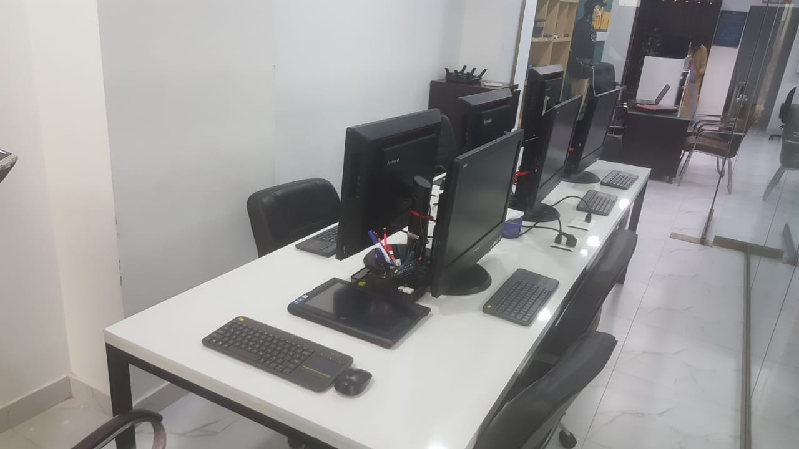
Virtual Security Cyber Lab – Equipment

Slide 101
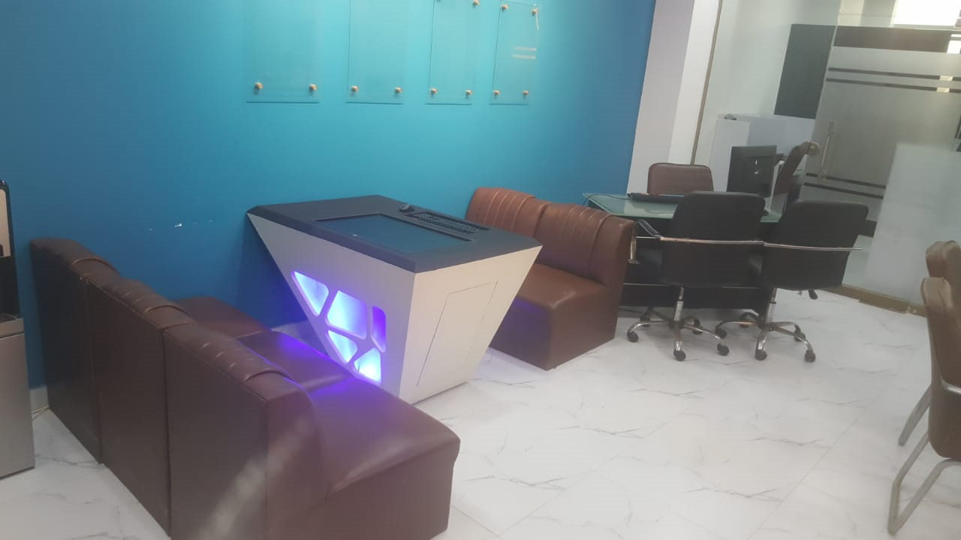

Virtual Security Cyber Lab – Equipment (Cont’d…)

Slide 102
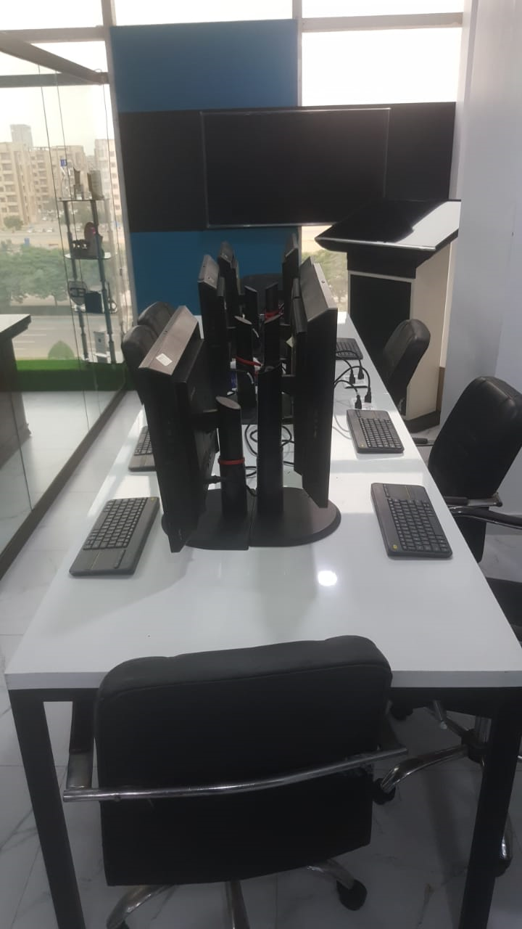
Virtual Security Cyber Lab – Equipment (Cont’d…)

Slide 103
Virtual Security iLab
The iLab is accessible to those candidates who are working and joining us remotely, the purpose of this iLab is to provide a virtual environment to the candidates alone with the list of task to be completed with the help of guidelines and examples. We have made a comprehensive hands on technical guide which is self explanatory and easy to access remotely. Our dedicated IP Addresses are on the forum of virtual security which we assign to the candidate after creating their ID’s and accessible time to and from.
Our iLab demonstration contains actual and authentic commands and there description, for each command a candidate will find the description in depth and the reason for issuing the command with examples can be seen in our hands on guide.
Our Dedicated IP Ranges allows virtual connectivity with our Virtual server(s), an easy approach for accessing the iLab is whenever a candidate fills online subscription and pays charges for it there username actives and the timeslot has been allocated to them.

Slide 104
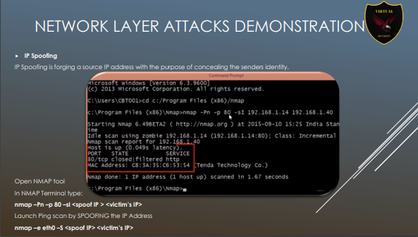
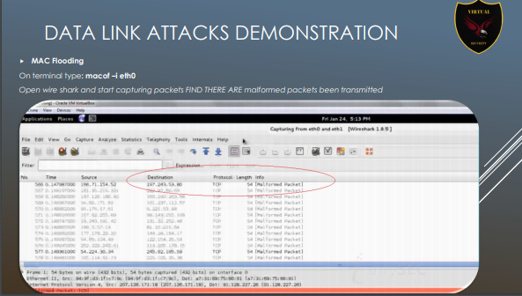
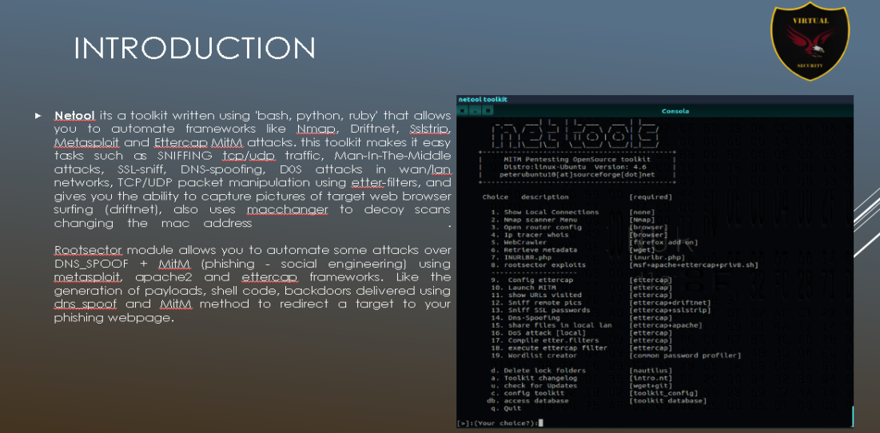
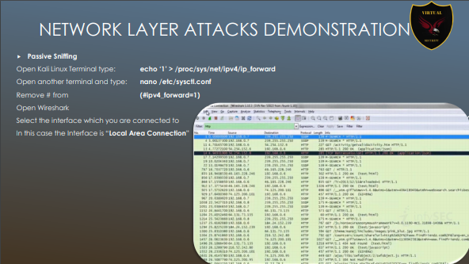
Virtual Security iLab – Hands on Guide (Cont’d…)

Slide 105
Final Year Project Ideas

Slide 106
Final Year Project Ideas
Our senior Advisors who belongs to different industries and organizations playing a vital role in providing Final year Project Ideas which currently the market required.
We help candidates to Design, Develop and Present a project which can further use as a product in the market. The ideas for the projects helpful for (Researchers, Bachelors Students, Masters Students, and PHD Candidates) only;
If you are looking for our final year project help service. You will get the awesome quality custom project according to your requirement. The projects are completely guided and assist by the professional instructors along all the related material required for research and educational purposes.
We assist Candidates related to the field mentioned below in creating a real world final year projects:
Computer Science / Computer Engineering;
Telecommunication & Networks;
Information Security / Cyber Security;
ERP / BSc Hons;

Slide 107
Team Profiles

Slide 108
Team Profiles
Professional Experience of Staff
Employee Name | Email Address | Designation | Experience # of Years | Certifications / Education
Ambreen Siddiqui | Ambreen@virtualsec.org | Managing Partner | 7 | Graduate, ITILv3, ISFS, CCS
Shujaat Hussain | shujaat@virtualsec.org | Project Manager | 5 | Bachelors in Engineering, ITIL v3, ISFS
Muhammad Adnan | madnan@virtualsec.org | Team Lead | 3 | Bachelors in Computer Science
Mashal Naz Malik | mashal@virtualsec.org | Assistant Manager | 3 | Masters in Information Security (MS-IS)
Syed Hassan Alam | Hassan@virtualsec.org | Client Relationship Manager | 5 | BS (Computer Science), ITIL v3
Junaid Aziz Khokhar | junaid@virtualsec.org | VMware Professional | 6 | Bachelors in Telecommunication & networks
Muhammad Danish Sajjad | Consultant_Danish@virtualsec.org | Information Security Consultant | 6 | Bachelors (CS), CCNA, CEH,
Manal Shahid | manal@virtualsec.org | Assistant Manager Business Development | 2 | Bachelors (BS)
Saif Hussain | saif@virtualsec.org | Information Security Analyst | 2 | Bachelors (BEE), CCNA, DFCS, CTI, CSA, UEH
Ayesha Ali | ayesha@virtualsec.org | Digital Forensics & Incident Response Analyst | 1 | Masters in Information Security (MS-IS)
Syed Muhammad Abdul Basit Ashrafi | basit@virtualsec.org | Information Security Analyst | 1 | Bachelors in Computer System Engineering
Sarib ul Haq | sarib@virtualsec.org | Information security Analyst | 1 | Masters in Information Security
Fazeel Ul Haq | fazeel@virtualsec.org | Information Security Analyst | 1 | Bachelors in Computer Science
Iqbal Ahmed | iqbal@virtualsec.org | Information Security Analyst | 1 | Bachelors in Computer Science

Slide 109

Team Profiles
Ambreen Siddiqui | Managing Partner
Education / Qualification | Graduate
Professional Profile
Ambreen Siddiqui is a highly accomplished professional with a successful career in the field of cybersecurity. She has been running her firm for last 8 years as a managing partner at Virtual Security, she is responsible for leading the company's efforts in providing cybersecurity services to clients worldwide. With a focus on leadership and project delivery, Ambreen is dedicated to delivering quality services that meet the unique needs of each client.
Beyond her work at Virtual Security, Ambreen is also an active speaker on the topic of cybersecurity, particularly with regards to women's empowerment in the field. She is an enthusiastic advocate for promoting greater representation of women in cybersecurity, and has dedicated much of her career to creating opportunities for other women to succeed. She has completed various certifications related to information security Ambreen is an accomplished speaker, having delivered presentations and keynotes at a variety of events and conferences worldwide. Her talks focus on a range of topics related to cybersecurity, including digital forensic incident handling, client relationship management, and budgeting and forecasting. In addition to her professional accomplishments, Ambreen is also known for her commitment to giving back to her community. She is actively involved in various philanthropic activities including supporting educational initiatives and empowering underprivileged women in Pakistan.
As a woman who empowers other women in the field of cybersecurity, Ambreen is an inspiration to many. She has been instrumental in founding and representing the WiCYS Pakistan chapter, which aims to empower women in cybersecurity through networking, mentorship, and professional development opportunities. Ambreen is also a role model for women looking to succeed in cybersecurity industry.

Slide 110

Team Profiles
Shujaat Hussain | Project Manager (Saudi Representative)
Education / Previously Work Graduate | ELMACS
Professional Profile
Shujaat Hussain has been working in virtual security for last 5 years. He has good understanding of implementing InfoSec and IT security Appliances, performing Vulnerabilities Assessment / Penetration testing, Network and operating systems security review, Shujaat has expertise in working on different projects related Digital Forensic Investigations.
Expertise
Live Forensic Acquisition
Chain of Custody
Forensics Analysis
Indexing, Keyword based Searching
Imaging (Bit-by-bit, Stream)
Physical Drive Imaging
Recovery of Deleted Data
Reporting

Slide 111

Team Profiles
Saif Hussain| Information Security Analyst
Education / Qualification | Graduate
Professional Profile
Saif Hussain has been working in Virtual Security since 2023. He is working in Information Security & Digital Forensic related work including vulnerability assessment, penetration testing, mobile application security assessment, data compromise assessment, compromise assessment, digital forensic.
Expertise
Vulnerability Assessment & Penetration testing / OT Cybersecurity;
Cloud Security Assessment;
Digital Forensic;
Compromise Assessment;
Mobile Application Security Assessment;
Network Architecture Review;
Certifications
Digital Forensic & Cyber Security (NAVTTC)
ISO/IEC 27001 Skill front Information Security Associate
System Security Certified Practitioner (SSCP)
ICS / OT Cyber Security ( UtilSec )

Slide 112

Team Profiles
Muhammad Adnan | Team Lead (Representative Norway)
Education / Qualification | Graduate |Remote Working
Professional Profile
Muhammad Adnan has recently done is graduation from Poltava university of computer sciences (Ukraine) he has joined virtual security recently and he is currently leading as a Cyber Security Consultant and working for multiple project partially collaborative with other firms. He has also expertise in the implementation, analysis, optimization, troubleshooting and documentation of LAN/WAN Network Systems. Moreover, He has the track record for diagnosing complex problems and consistently delivering effective solutions.
Adnan has experienced in governing Information Technology and leading teams for various IT and business functions. Possess project management skills and leadership qualities, Work for VirtualSec Forensic Technology team to assist our Forensic Function in the Investigations and other related services, that specifically includes maintaining chain of custody for suspected systems, imaging of hard- drives data, indexing and retrieval of data for the key word searches and other data analysis where needed.
Expertise
Vulnerability Assessment & Penetration testing of Servers & Mobile Applications;
Projects Planning, Executions & Leadership;
Technical Analysis & IT Strategy Development;
Ability to conduct Mobile Security assessment from scratch;
OSI 7 Layer security assessment;
Mobile Application Security assessment; and
Conducted several reviews related to configurations of Network OS and Databases.

Slide 113

Team Profiles
Mashal Naz Malik| Assistant Manager Information Security
Education / Qualification | Masters – Information Security
Professional Profile
Mashal Naz has been working in Virtual Security Since 2021. She is working in Information Security division, her responsibility includes understanding of technical requirements, conduct manual VA/PT of the provided scope by the client, conduct network configuration review and exclude false positive, provide realistic remediation's to the clients.
Mashal is actively engaged with various clients in UAE, she has been working and understanding the client requirements and provide technical input and clarity to the security assessment. She further prepare complete POC of the tested findings which may be useful for the client in later stages.
Expertise
Vulnerability Assessment & Penetration testing
Source Code Review
Network configuration review
Incident Response & Handling
Digital Forensic Including (Chain of Custody, Evidence preservation, Imaging, analysis, Recovery & reporting.

Slide 114

Team Profiles
Syed Hassan Alam | Client Relationship Manager
Education / Qualification | Graduate
Professional Profile
Syed Hassan Alam is currently leading as a Client Relation Manager and handle all the queries which faced by the client. He has been working in virtual security for last 3 years.
Hassan is currently associated with Virtual Security and has been leading in multiple project partially collaborative with other firms. Hassan has experienced in understanding and converting the client requirements into project goals and objective, moreover he has focused on the domain of Project Management:
Expertise
Acquisition
Chain of Custody
Forensics Analysis and
Imaging (Bit-by-bit, Stream)

Slide 115

Team Profiles
Junaid Aziz Khokhar | ERP/VMWare Consultant
Education / Qualification | Graduate
Professional Profile
Junaid Aziz has been working in Virtual Security since 2016. He is totally working in Providing VM-Ware and Cloud Trainings.
Mr. Junaid has 3 years of experience in Cloud Services, VM-Ware (Esxi) Servers; Junaid has also worked in the contribution of Cloud based services which includes (PaaS, SaaS). He is responsible for the security administration of the network infrastructure of various clients.
Expertise
VMWare Hypervisor
ESXI Servers
S4 (HANA)
E100 SAP
Oracle / DB2
LDAP
Cent OS
Certifications
ITIL
CVA

Slide 116

Team Profiles
Muhammad Danish Sajjad| Information Security Consultant
Education / Qualification | Graduate (CS)
Professional Profile
Mr. Danish Sajjjad has been working in Virtual Security since 2016 .He is totally working in providing advisory and consultancy services to various clients in Information security.
Danish Sajjad is working as a Cyber Security Consultant at virtual security, he simulates attacks to identify and report security flaws as a highly skilled specialist in information security, working with both government and private sector.
Expertise
Cloud Computing;
Cyber Security;
Certifications
CCNA (Cisco Certified Network Associate)
CEH (Certified Ethical Hacker)
CISM Certified Information Security Manager.
IT Service Management Associate Skill Front

Slide 117

Team Profiles
Manal Shahid| Assistant Manager Business Development
Education / Qualification | Bachelors
Professional Profile
Manal Shahid has been working in Virtual Security Since 2022. She is working in Information Security business development, her responsibility includes client project understanding, client communication, project delivery and financials.
Manal is actively engaged with client relationship development, she has been working and understanding the client requirements and communicate it to the technical team in order to provide absolute result as per client expectations.
Expertise
Project Information Gathering
Working on tenders and RFP
Queries Responses and Marketing
Communication of expected delivery to the team.

Slide 118

Team Profiles
Hashir Junaid| Information Security Intern
Education / Qualification | trainee Information Security
Professional Profile
Hashir Junaid has been working in Virtual Security since 2022. He is working in Information Security & Digital Forensic related work including vulnerability assessment, automated and manual penetration testing.
Hashir is currently in learning phase, he is more engages towards manual pen testing, a part from VA/PT he has also been enrolled in bug bounty Program i.e. YESWEHACK, HACKERONE, BUG CROWD.
Expertise
Reconnaissance
Enumeration
Scanning
Vulnerability Assessment
Penetration Testing (Manual)
Bug Bounty Hunting;
SCADA/ICS GAP Assessments;

Slide 119

Team Profiles
Syed Muhammad Abdul Basit Ashrafi| Information Security Analyst
Education / Qualification | Graduate
Professional Profile
Since 2023, Syed Muhammad Abdul Basit Ashrafi has been employed with Virtual Security. He performs tasks connected to information security and digital forensics, such as mobile application security evaluation, vulnerability assessment, penetration testing, and evaluation of data compromise and compromise assessment.
Expertise
Vulnerability Assessment & Penetration testing;
Bug Bounty Hunting;
Cloud Security Assessment;
Digital Forensic;
OT Cybersecurity Review
Compromise Assessment;
Mobile Application Security Assessment;
Network Architecture Review;

Slide 120

Team Profiles
Ayesha Ali | Digital Forensics & Incident Response Analyst
Education / Qualification | Graduate/Masters (Continued)
Professional Profile
Since 2024, Ayesha Ali has been employed with Virtual Security. She performs tasks connected to information security and digital forensics, such as mobile application security evaluation, vulnerability assessment, penetration testing, evaluation of data compromise, imaging, image analysis, memory forensics, network forensics, database forensics and compromise assessment.
Expertise
Vulnerability Assessment & Penetration testing;
Digital Forensic;
Compromise Assessment;
Mobile Application Security Assessment;
Certifications
Google Cybersecurity Certification

Slide 121

Team Profiles
Sarib Ul Haq| Information Security Analyst
Education / Qualification | Graduate
Professional Profile
Sarib Ul Haq has been working in Virtual Security since 2022. He is working in Information Security & Digital Forensic related work including vulnerability assessment, penetration testing, mobile application security assessment, data compromise assessment, compromise assessment, digital forensic.
Expertise
Vulnerability Assessment & Penetration testing / OT Cybersecurity;
Cloud Security Assessment;
Digital Forensic;
Compromise Assessment;
Mobile Application Security Assessment;
Network Architecture Review;
Certifications
CEH - Certified Ethical Hacker
CHFI - Certified Hacker Forensic Investigator
CND - Certified Network Defender

Slide 122

Team Profiles
Fazeel Ul Haq| Information Security Analyst
Education / Qualification | Graduate
Professional Profile
Since 2023, Fazeel Ul Haq has been employed with Virtual Security. He performs tasks connected to information security and digital forensics, such as mobile application security evaluation, vulnerability assessment, penetration testing, and evaluation of data compromise and compromise assessment.
Expertise
Vulnerability Assessment & Penetration testing;
Cloud Security Assessment;
Digital Forensic;
Bug Bounty Hunting;
OT Cybersecurity review;
Compromise Assessment;
Mobile Application Security Assessment;
Network Architecture Review;

Slide 123

Team Profiles
Iqbal Ahmed| Information Security Analyst
Education / Qualification | Graduate
Professional Profile
Since 2023, Iqbal Ahmed has been employed with Virtual Security. He performs tasks connected to information security and digital forensics, such as mobile application security evaluation, vulnerability assessment, penetration testing, and evaluation of data compromise and compromise assessment.
Expertise
Vulnerability Assessment & Penetration testing;
Bug Bounty Hunting;
Cloud Security Assessment;
Digital Forensic;
OT Cybersecurity Review
Compromise Assessment;
Mobile Application Security Assessment;
Network Architecture Review;

Slide 124
Global certifications

Slide 125
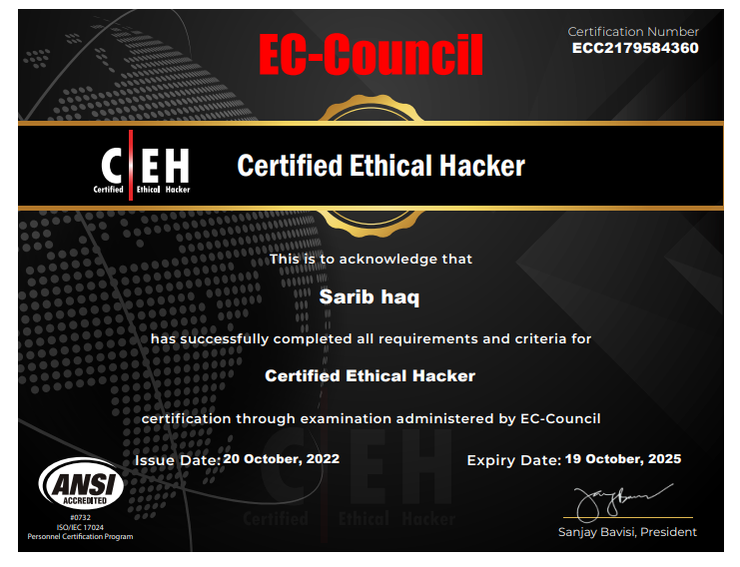
Global certifications

Slide 126
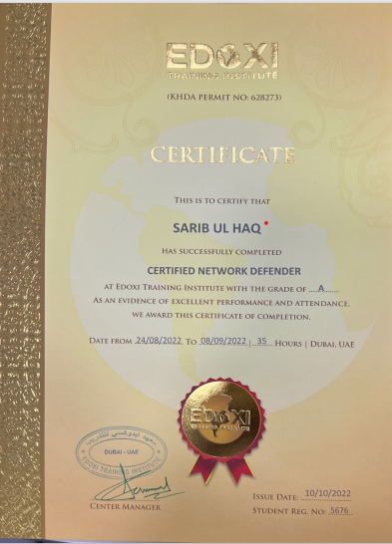
Global certifications

Slide 127
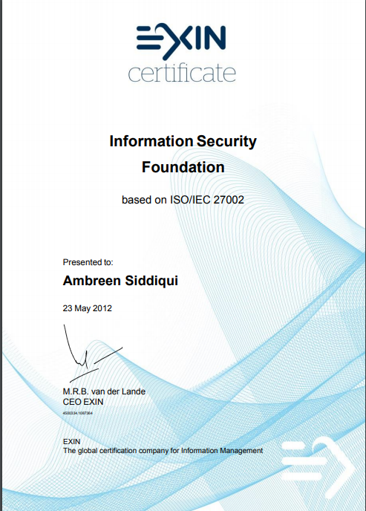
Global certifications

Slide 128

Global certifications

Slide 129
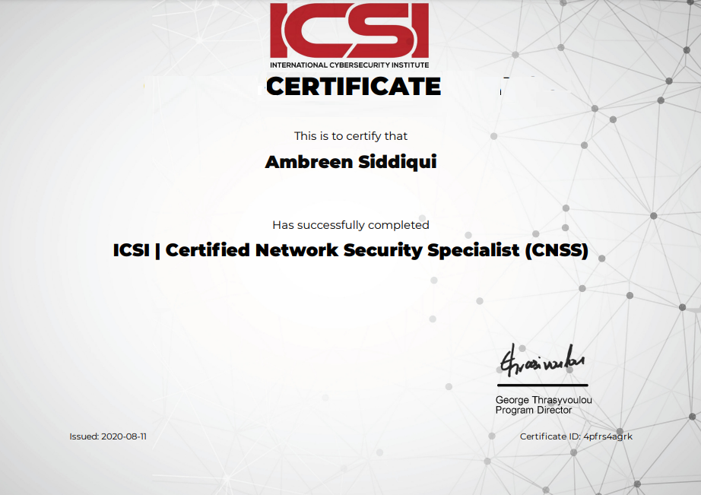
Global certifications

Slide 130
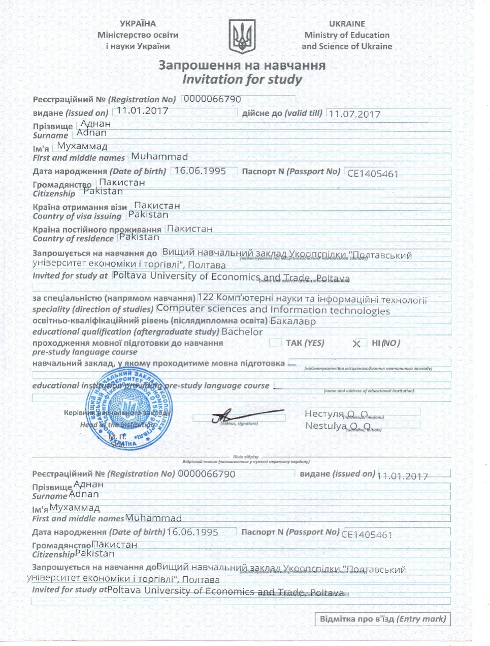
Global certifications

Slide 131
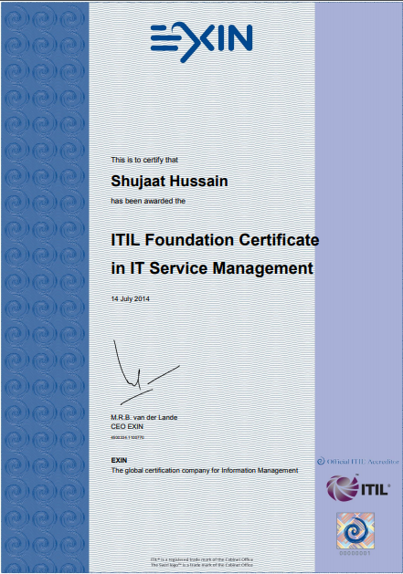
Global Certifications

Slide 132
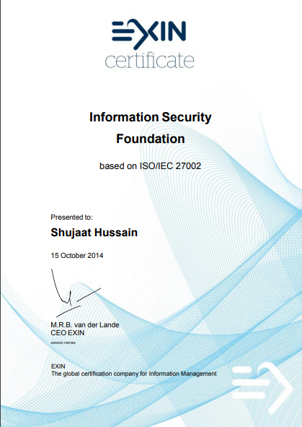
Global Certifications

Slide 133

Global Certifications

Slide 134
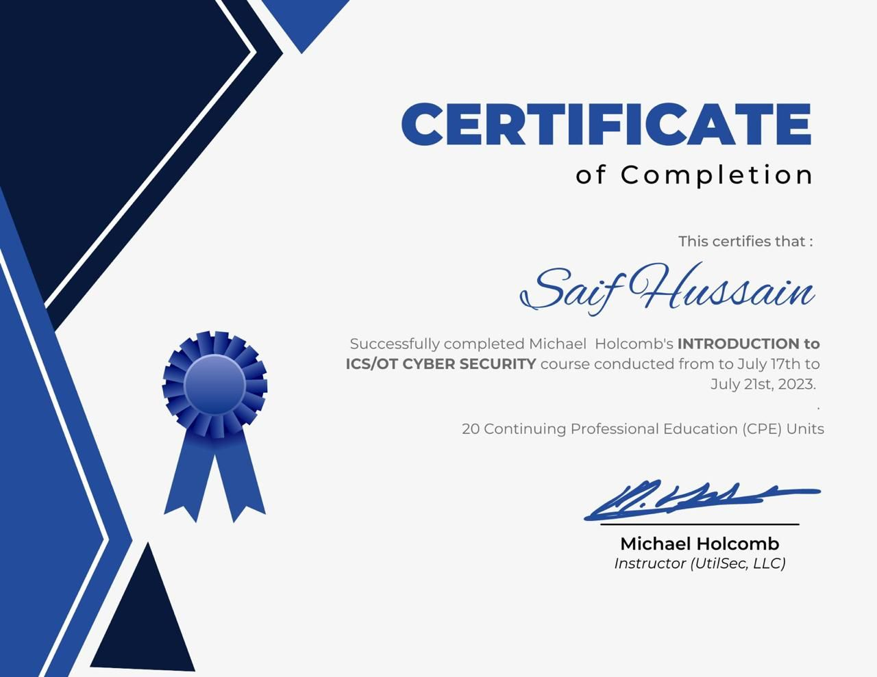
Global Certifications

Slide 135
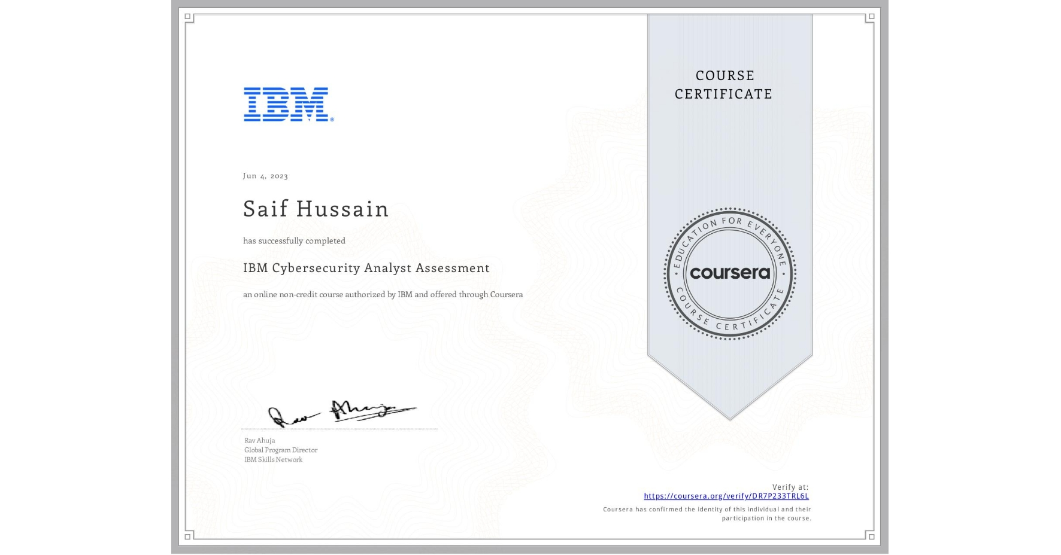
Global Certifications

Slide 136
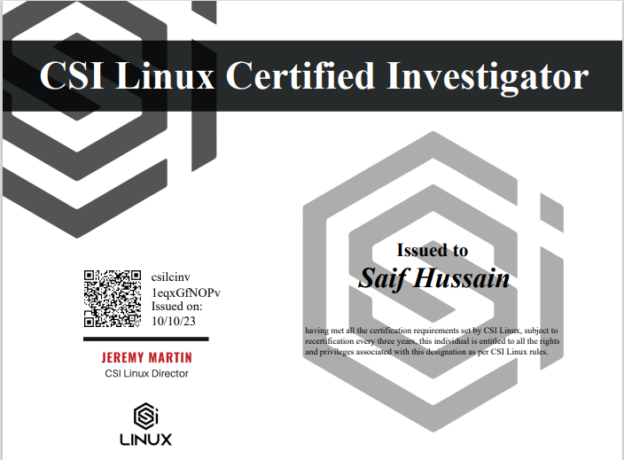
Global Certifications

Slide 137

Global Certifications

Slide 138

Global Certifications

Slide 139

Global Certifications

Slide 140
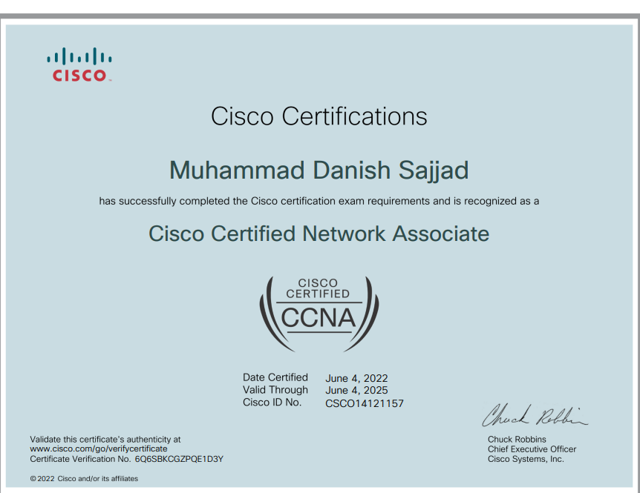
Global Certifications

Slide 141
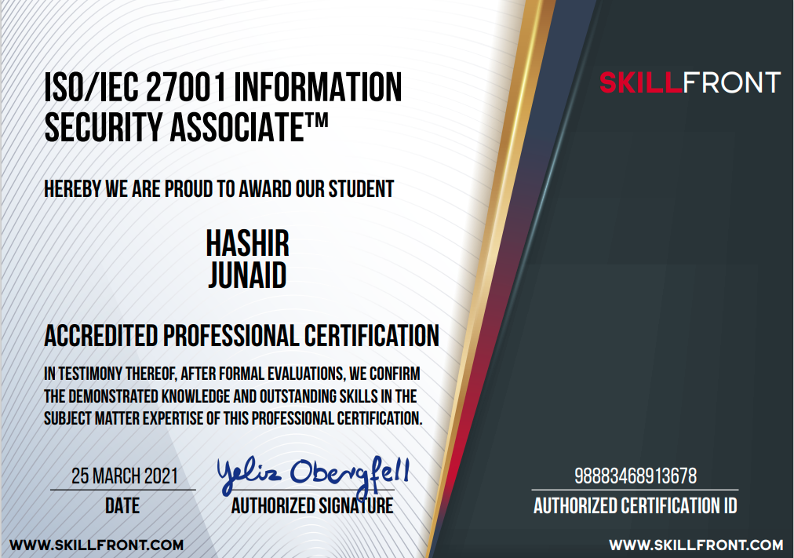
Global Certifications

Slide 142

Global Certifications

Slide 143
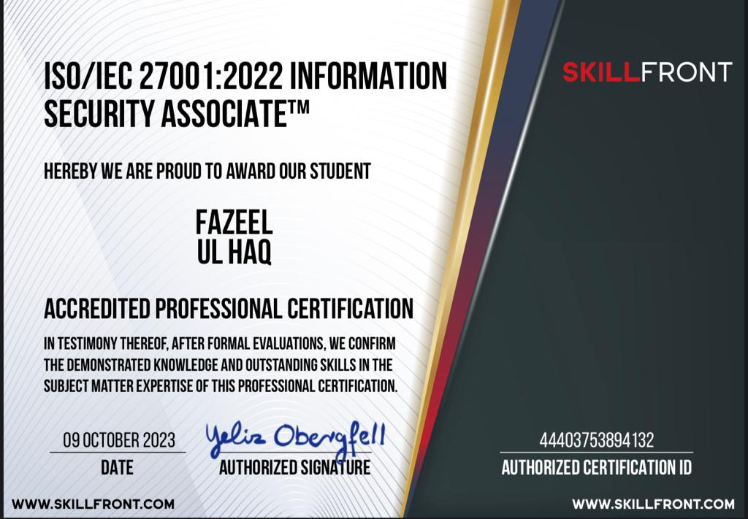
Global Certifications

Slide 144
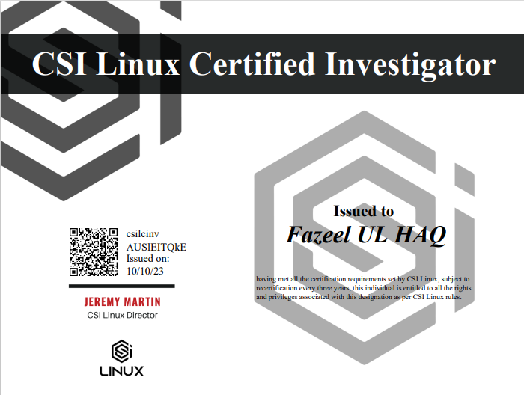
Global Certifications

Slide 145
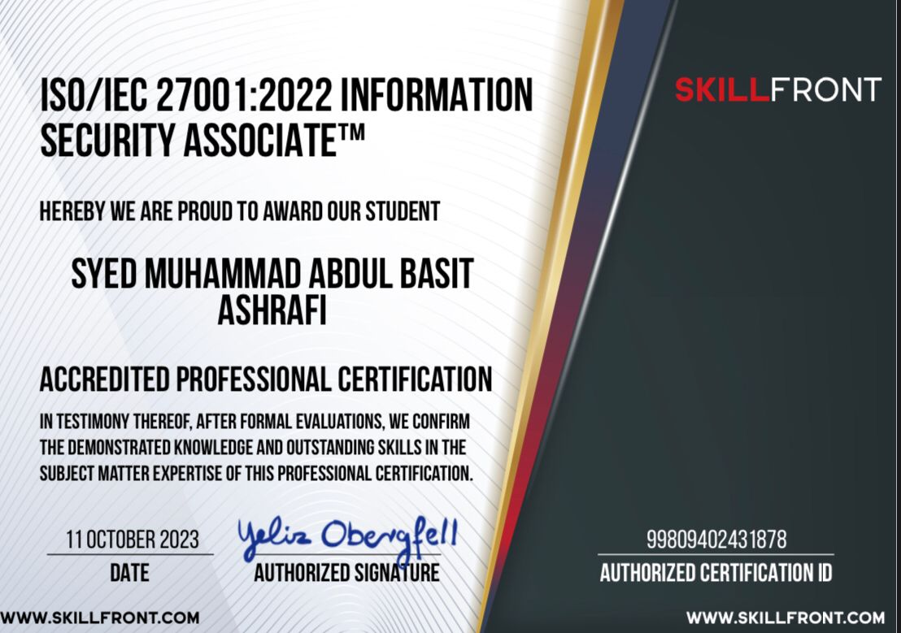
Global Certifications

Slide 146
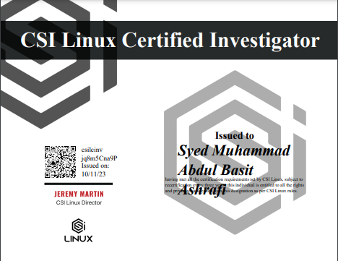
Global Certifications

Slide 147

Global Certifications

Slide 148
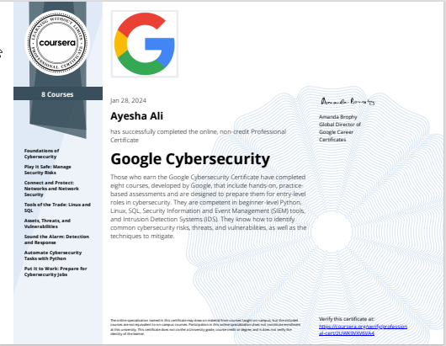
Global Certifications

Slide 149

Global Certifications

Slide 150
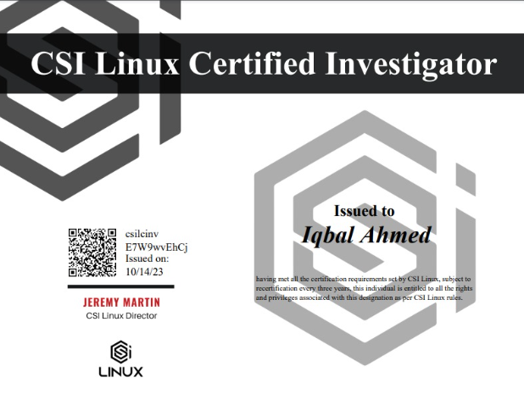
Global Certifications

Slide 151
Customer references

Slide 152
Key Credentials
S. No. | Client Name | Organization Description |  | Work Done
Banking & Finance
1 | Habib Qatar |  | Habib Qatar International Exchange Pakistan (Pvt.) Ltd is one stop for foreign currency exchange and home remittance. | VA/PT – Mobile, network, Servers (20 IP Addresses)
2 | UBL Insurers |  | UBL Insurers Limited is a company owned by United Bank Limited (UBL) and its sponsors Abu Dhabi and Best way Group, set up as a strategic initiative for UBL. | VA/PT – Mobile, network, Servers (10 IP Addresses)
3 | Samba Bank |  | Samba Bank Limited is a majority owned subsidiary of Samba Financial Group of Saudi Arabia | VA/PT – Network, Servers (18 IP Addresses)
4 | Burj Bank |  | Burj Bank Limited, formerly known as Dawood Islamic Bank Limited (DIBL), is Pakistan's sixth full-fledged Islamic commercial bank | VA/PT - Servers (40 IP Addresses)
5 | Habib Bank Limited |  | HBL now referred to as "HBL Pakistan" and headquartered in Habib Bank Plaza, Karachi, Pakistan, is the largest bank in Pakistan. The bank has a network of over 1500 branches and over 1000 ATM in Pakistan and 55 branches worldwide. | Digital Forensic Engagement
6 | Habib Metropolitan Bank |  | Habib Metropolitan Bank was incorporated in Pakistan as a Public Listed Company in 1992 under the name, Metropolitan Bank Limited. | VA/PT – Mobile, Servers, ATM’s (50 IP Addresses) Digital Forensic Engagement
7 | Tameer Micro Finance Bank |  | Telenor Microfinance Bank Limited" formerly "Tameer Microfinance Bank Limited is Pakistan's Largest and the first private commercial Microfinance bank licensed by the State Bank of Pakistan | VA/PT – Mobile App (5 IP Addresses)
8 | Silk Bank Limited |  | On September 15, 2001, under the supervision of the State Bank of Pakistan (SBP), the institution then known as the Prudential Bank was acquired by the management and associates of the Saudi Pak Industrial and Agricultural Investment Company (Pvt) Ltd (SAPICO). | VA/PT – Mobile App (2 IP Addresses)
9 | JS Bank Limited |  | JS Bank is a majority-owned subsidiary of Jahangir Siddiqui & Co. Ltd. and currently operates 307 branches in 152 cities | VA/PT –Servers (4 Public IP Addresses)

Slide 153
Key Credentials (Cont’d…)
S. No. | Client Name | Organization Description | Work Done
IT & Telecommunication
10 | Trans world | Transworld Enterprise Services is the Preferred Choice of high quality internet in Pakistan. | VA/PT – Network, Servers (16 IP Addresses)
11 | Pakistan Mercantile Exchange | The Only Platform in Pakistan to Buy, Sell, Trade - Gold, Silver, Crude Oil, Agriculture and Financial Futures. Pakistan Mercantile Exchange is the first technology | VA/PT – Network, Servers (35 IP Addresses)
12 | Wemyt (We Manage Your Technology) | We Manage Your Technology Founded by seasoned IT business Professionals Bearing years of experience within the domain of business consulting and system integration | VA/PT – Servers (12 IP Addresses)
13 | PTCL | PTCL is all set to redefine the established boundaries of the telecommunication market and is shifting the productivity frontier to new heights. Today, for millions of people, we provide instant access to new products and ideas. | Training (Ethical Hacking & digital Forensic)
14 | SAT MAP | SATMAP is a neural network based Artificial Intelligent system which routes the calls to agents intelligently on the basis of agent . | Training (Ethical Hacking & digital Forensic)
15 | Cube XS Weatherly | CubeXS Weatherly Pvt. Ltd is first tier 4 compliant data center in Pakistan. Our public cloud is self-managed, fast and on pay-as-you-grow model | Training (Ethical Hacking & digital Forensic)
Audit Firms
16 | BDO | BDO is a global professional audit firm that provides Advisory and consultancy services to UAE, Pakistan. | Work in consortium with BDO for VA?PT
17 | KPMG | KPMG is a global network of professional firms providing Audit, Advisory and Tax services. KPMG is one of the largest professional services firm in the world and is one of the "Big Four" accounting firms | Training (Ethical Hacking & digital Forensic) Work in Consortium with KPMG for VA/PT
18 | Earnest & Young | EY is a multinational professional services firm headquartered in London, United Kingdom. EY is one of the largest professional services firm in the world and is one of the "Big Four" accounting firms | Training (Ethical Hacking & digital Forensic)

Slide 154
Key Credentials (Cont’d…)
S. No. | Client Name | Organization Description | Work Done
Power Generation Organization
19 | KAPCO | The Kot Addu Power Company Limited (KAPCO), was incorporated in 1996, location in Kot Addu, District Muzaffargarh, Punjab, Pakistan | VA/PT – Network, Servers (14 IP Addresses)
Academic Institutions
20 | PAF KIET | Pakistan Air Force (Karachi Institute of Economics & technology, The Institute promotes the environment of hard work, discipline, leadership and professionalism. There is a focus on providing quality facilities that students and parents desire and expect from an institution | Final year project (Advisory and Development)
Property & Development
21 | Property Prime Time | Deals in sales/purchase and rent in all kind of properties, Online sales and purchase of Property in DHA Karachi | VA/PT - Infrastructure
22 | PAF Friends Enterprises | PAF Friends enterprises is the government contractor manage and develop project outside the cities. | VA/PT - Infrastructure
23 | Khan Muhammad Khan and Co | Khan Muhammad Khan and Co believes that it’s repudiation’s reliant on the type of manpower it Supplies to it’s clients. | VA/PT - Infrastructure
Entertainment
24 | Universe Cineplex | UNIVERSE CINEPLEX was founded in September 2003. It is a modern state of the art Cineplex, housings five CINEMAS, the only cinema showing 3D and 4D movies in town with an expansive lobby. | VA/PT Cinema Application
Textile Industry
25 | Afroze Textile | Afroze Textile Industries is one of the leading textile groups of the country. It is having various units which comprises of Terry Towel and home textiles. | VA/PT - Infrastructure

Slide 155
Association & Partnership

Slide 156












Association & Partnership
Global Association & Partnership
VIRTUAL SECURITY SPONSORSHIPS (EDUCATIONAL INSTITUTIONS)

Slide 157
Contact US

Slide 158
Virtual Security Contact Information:
Ambreen Siddiqui | Managing Partner
ambreen@virtualsec.org
Shujaat Hussain | Project Manager
shujaat@virtualsec.org
Manal Shahid | Assistant Manager – Business Development
manal@virtualsec.org
Saif Hussain| Information security analyst
saif@virtualsec.org
Contact Information: +92-311-1240944 Pakistan | +966-57242-5506 (Saudi)
Address Head Office: Suite # L3-08 4th Floor AQ Business Centre, Jinnah Avenue, Bahria Town Karachi 75340 Pakistan.
Research & Development Lab: Marshala Veresouva 84, Near ekvator Mall Poltava, Ukraine 36042.
Website: - http://www.virtualsec.org
Skype: VirtualSecurityOnline
WhatsApp: +92-311-1240944 NTN: 5139194

