Slide 1
Anatomy & Physiology of the Gastrointestinal Tract (GIT)
Structure, Functions & Clinical Relevance
Presented by: Dr. Muhammad Ejaz

Slide 2
Introduction
The GIT is a continuous muscular tube from the mouth to the anus.
Main functions: Ingestion, digestion, absorption, and excretion.
Accessory organs assist in digestive processes.

Slide 3
Major Parts of the GIT
1. Mouth
2. Pharynx
3. Esophagus
4. Stomach
5. Small Intestine (Duodenum, Jejunum, Ileum)
6. Large Intestine (Cecum, Colon, Rectum)
7. Anus

Slide 4
Accessory Digestive Organs
Salivary glands
Liver
Gallbladder
Pancreas

Slide 5
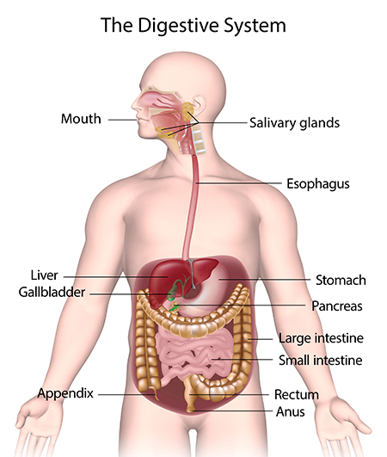

Slide 6
mouth
The mouth is the first part of the digestive system where the process of digestion begins. It plays both a mechanical and a chemical role in breaking down food
Mechanical digestions
Chemical digestions

Slide 7
1. Mechanical Digestion
Teeth: Cut, tear, and grind food into smaller pieces (mastication), increasing the surface area for enzymes to act.
Tongue: Helps move food around, mixes it with saliva, and forms it into a soft ball called a bolus. It also pushes the bolus toward the pharynx to be swallowed.

Slide 8
Types of Teeth in Humans
Incisors
  Location: Front of the mouth (4 upper, 4 lower → total 8).
  Shape: Sharp, chisel-shaped.
  Function: Cutting and slicing food.
Canines
  Location: Next to incisors (2 upper, 2 lower → total 4).
  Shape: Pointed, cone-shaped.
  Function: Tearing and piercing food (especially meat).

Slide 9
Types of Teeth in Humans
Premolars (Bicuspids)
  Location: Behind canines (4 upper, 4 lower → total 8).
  Shape: Broad surface with ridges.
  Function: Crushing and grinding food.
Molars
  Location: At the very back (12 in adults, including 4 wisdom teeth).
  Shape: Large, flat surface with cusps.
  Function: Grinding and chewing food into fine particles.

Slide 10
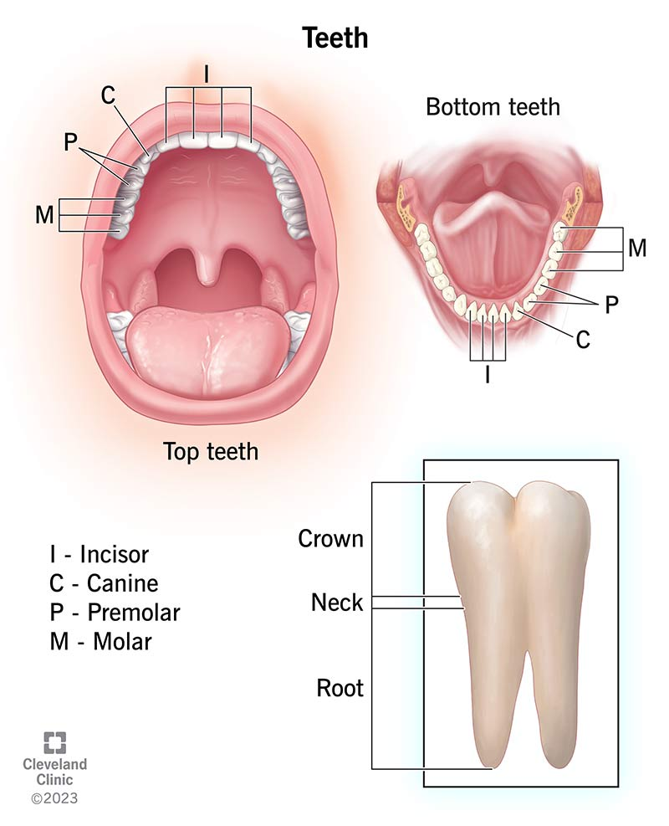

Slide 11
2. Chemical Digestion
Salivary glands (parotid, submandibular, sublingual) secrete saliva, which contains:
  Water: Moistens and softens food.
  Mucus: Helps in swallowing.
  Salivary amylase (ptyalin): Begins the breakdown of starch (carbohydrates) into maltose (simple sugar).
  Lysozyme: Has antibacterial action.

Slide 12
Salivary glands
The salivary glands are important accessory organs of the digestive system. They produce saliva, which helps in lubrication, chemical digestion, cleaning of mouth, and protection against infection.

Slide 13
Types of Salivary Glands
There are three pairs of major salivary glands and many minor ones:
1. Parotid Glands
Location: In front of and just below each ear.
Duct: Stensen’s duct opens near the upper second molar.
Secretion: Watery, rich in salivary amylase (for digestion of starch).
Largest salivary gland.

Slide 14
2. Submandibular Glands
Location: Beneath the lower jaw (mandible).
Duct: Wharton’s duct opens under the tongue.
Secretion: Mixed (both watery and mucus), helps in digestion and lubrication.

Slide 15
3. Sublingual Glands
Location: Under the tongue, in the floor of the mouth.
Ducts: Many small ducts open directly into the floor of the mouth.
Secretion: Thick, mucus-rich saliva (helps lubrication).

Slide 16
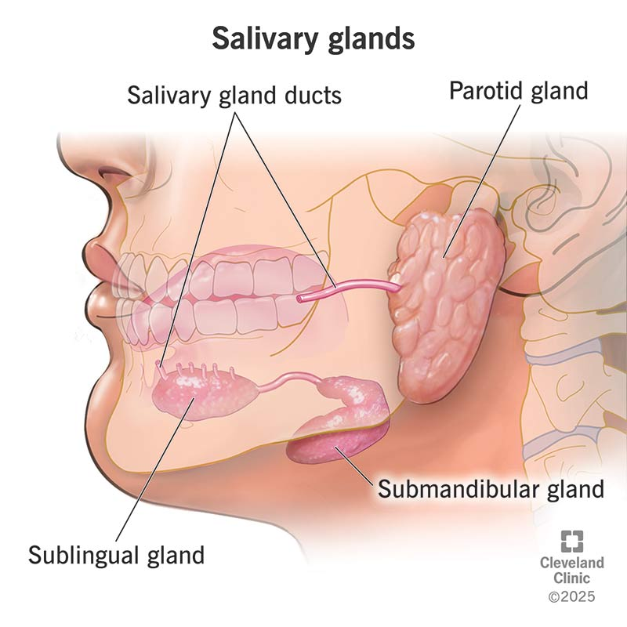

Slide 17
Functions of Saliva
Moistens and softens food → easy swallowing.
Contains salivary amylase (ptyalin) → starts digestion of starch.
Contains lysozyme → kills bacteria.
Helps in speech and keeps mouth moist.
Maintains oral hygiene by washing away food particles.

Slide 18
pharynx
The pharynx is a muscular, funnel-shaped tube that connects the mouth and nasal cavity to the esophagus and larynx. It plays an important role in digestion and respiration.

Slide 19
Structure of Pharynx
The pharynx is about 12–14 cm long and is divided into three parts:
1.Nasopharynx
  Location: Upper part, behind the nasal cavity.
  Function: Only respiratory (air passage).
  Contains pharyngeal tonsils (adenoids) and opening of Eustachian tube.
2.Oropharynx
  Location: Middle part, behind the oral cavity.
  Function: Common passage for food and air.
  Contains palatine tonsils.

Slide 20
3.Laryngopharynx (Hypopharynx)
Location: Lower part, continuous with esophagus and larynx.
Function: Directs food into the esophagus and air into the larynx.

Slide 21
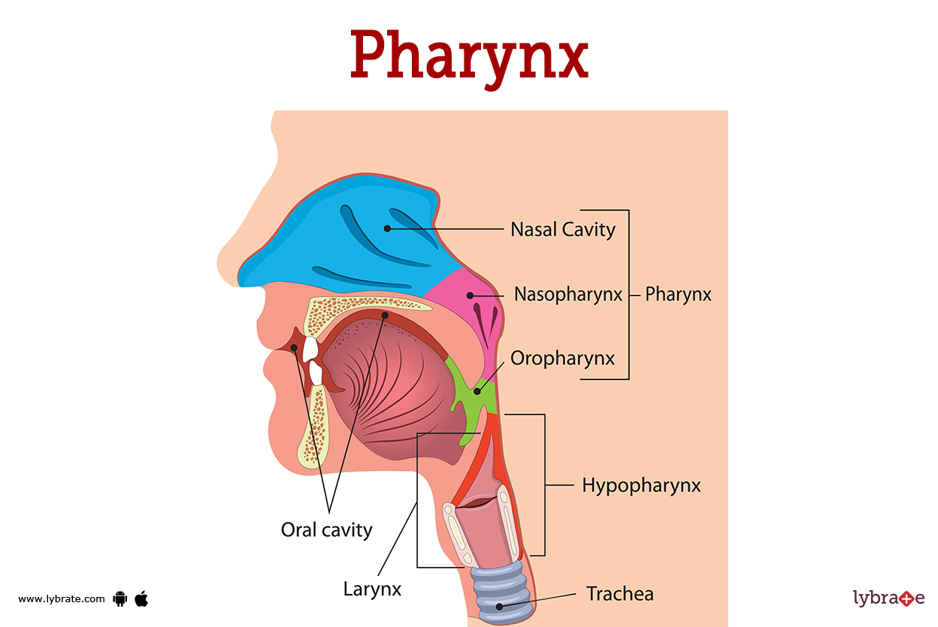

Slide 22
Functions of Pharynx
Digestion:
  Helps in swallowing (deglutition) by moving food from mouth → esophagus.
  Muscles contract to push the food bolus downward.
Respiration:
  Serves as a passageway for air from nasal cavity → larynx → trachea.
Protection:
  Tonsils in the pharynx provide immune defense against microbes entering through food or air.

Slide 23
Esophagus (Food Pipe)
The esophagus is a muscular tube that connects the pharynx to the stomach. It is about 25 cm (10 inches) long in adults.

Slide 24
Structure
Location: Lies behind the trachea and in front of the spine.
Layers of the esophagus (from inside to outside):
  Mucosa → secretes mucus for lubrication.
  Submucosa → contains glands and blood vessels.
  Muscularis externa → upper part has voluntary skeletal muscles, lower part has involuntary smooth muscles.
  Adventitia → outer protective layer.

Slide 25
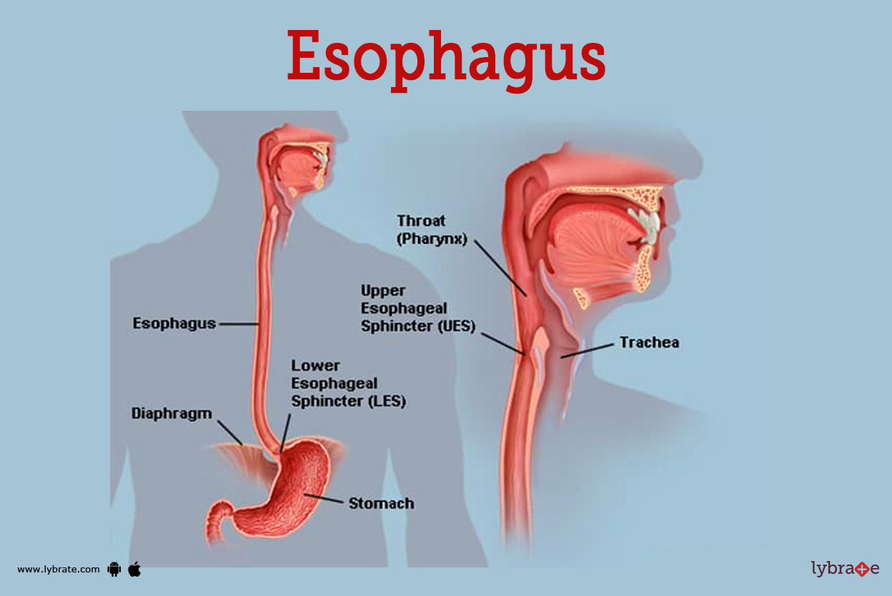

Slide 26
Functions
Passage of Food
  Carries the swallowed food (bolus) from the pharynx → stomach.
  No digestion takes place here.
Peristalsis
  A series of wave-like muscular contractions that push the food downward.
  Works even if you are upside down (gravity is not necessary).
Sphincters
  Upper esophageal sphincter (UES): Prevents air from entering the esophagus during breathing.
  Lower esophageal sphincter (LES): Prevents stomach contents (acid/food) from flowing back into the esophagus (reflux).

Slide 27
Stomach
The stomach is a J-shaped, muscular sac located between the esophagus and the small intestine (duodenum). It acts as a temporary storage tank and plays a major role in both mechanical and chemical digestion.

Slide 28
Parts of the Stomach
Cardiac region → area where food enters from the esophagus.
Fundus → dome-shaped upper part, stores undigested food and gases.
Body → main central portion where mixing and digestion occur.
Pylorus → lower part that connects to the small intestine.
  Contains pyloric sphincter which controls the release of chyme (partially digested food) into the duodenum.

Slide 29
Structure (Layers)
Mucosa → secretes gastric juice and mucus.
Submucosa → contains blood vessels and nerves.
Muscularis externa → three muscle layers (longitudinal, circular, oblique) for churning and mixing food.
Serosa → outer protective covering.

Slide 30
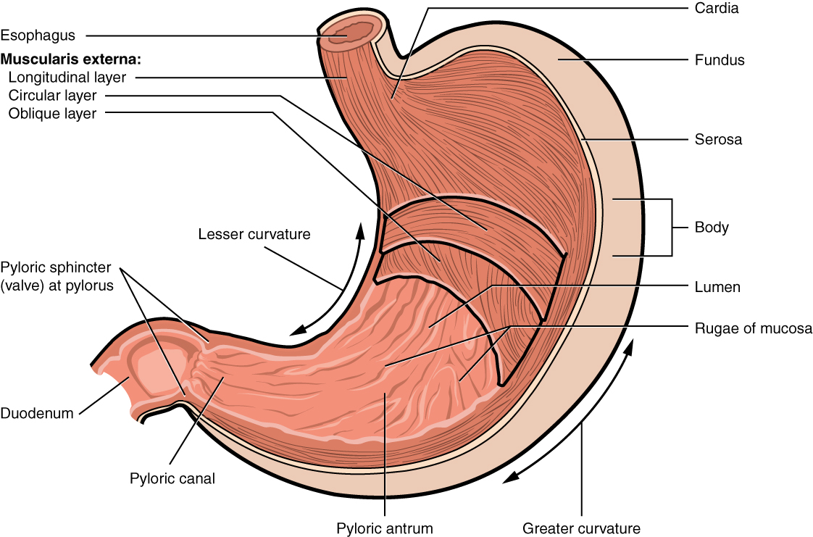

Slide 31
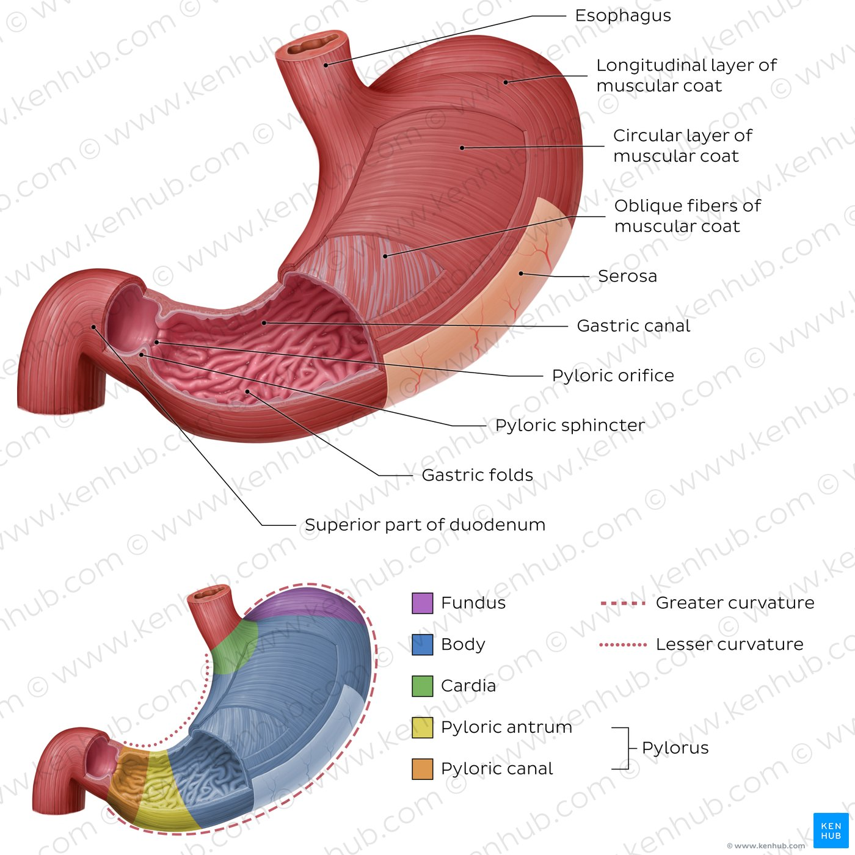

Slide 32
Functions of the Stomach
Mechanical digestion
  Strong muscular contractions (churning) mix food with gastric juice, forming chyme.
Chemical digestion
  Gastric juice contains:
    Hydrochloric acid (HCl): Kills bacteria, activates enzymes.
    Pepsin: Begins digestion of proteins into peptides.
    Intrinsic factor: Helps absorb Vitamin B12.
    Mucus: Protects stomach lining from HCl and pepsin.

Slide 33
Functions of the Stomach
Storage
  Holds food for 2–4 hours and releases it slowly into the small intestine.
Absorption
  Little absorption occurs here (mainly alcohol, water, some drugs like aspirin).

Slide 34
Small Intestine
The small intestine is a long, coiled, narrow tube about 6 meters (20 feet) long. It extends from the stomach (pylorus) to the large intestine (cecum).
It is the main site of digestion and absorption of nutrients.

Slide 35
Parts of the Small Intestine
1.Duodenum (about 25 cm / 10 inches)
  First part, C-shaped, connected to the stomach.
  Receives bile from the liver & gallbladder (for fat digestion) and pancreatic juice (enzymes for carbohydrates, proteins, fats).
  Main site for chemical digestion.
2.Jejunum (about 2.5 m)
  Middle part.
  Rich in blood supply.
  Main site of absorption of nutrients (sugars, amino acids, fatty acids, vitamins, minerals).

Slide 36
Parts of the Small Intestine
3.Ileum (about 3.5 m)
  Last and longest part.
  Absorbs vitamin B12, bile salts, and remaining nutrients.
  Ends at the ileocecal valve, which connects to the large intestine.

Slide 37
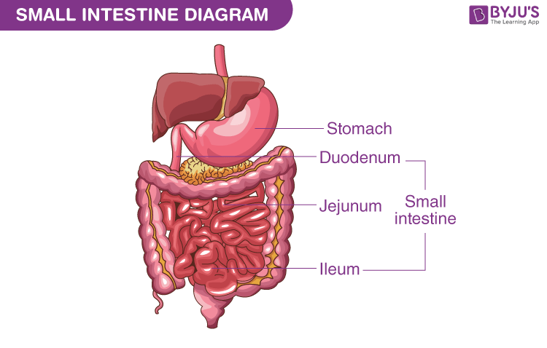

Slide 38
Structure
Inner lining has folds, villi, and microvilli → greatly increase surface area for absorption (called the brush border).
Lined with intestinal glands that secrete digestive enzymes and mucus.

Slide 39
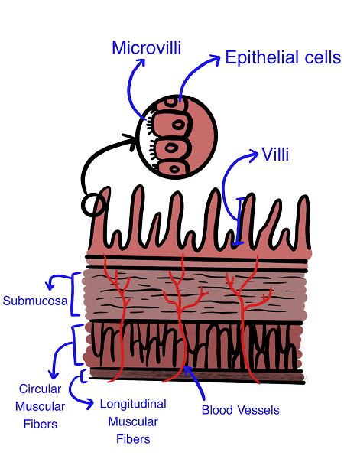

Slide 40
Functions of the Small Intestine
Digestion
  Enzymes from the pancreas (amylase, lipase, proteases) and bile salts help digest carbohydrates, fats, and proteins.
  Intestinal enzymes (maltase, lactase, sucrase, peptidases) complete digestion.
Transportation
  Moves food forward by peristalsis into the large intestine.

Slide 41
Functions of the Small Intestine
Absorption
  Jejunum & ileum absorb almost all nutrients:
    Carbohydrates → glucose
    Proteins → amino acids
    Fats → fatty acids & glycerol
    Vitamins & minerals
    Water (most of it)

Slide 42
Large Intestine
The large intestine is a wide, shorter tube (about 1.5 meters / 5 feet long) that extends from the ileum (end of small intestine) to the anus.
It is mainly responsible for absorbing water, salts, and forming feces.

Slide 43
Parts of the Large Intestine
Cecum
  Pouch-like beginning of the large intestine.
  Connected to the ileum by the ileocecal valve.
  Contains the vermiform appendix (a small finger-like structure, may help in immunity).
Colon → the major portion, divided into four parts:
  Ascending colon → goes upward on the right side.
  Transverse colon → runs across the abdomen.
  Descending colon → goes downward on the left side.
  Sigmoid colon → S-shaped, leads to rectum.

Slide 44
Parts of the Large Intestine
Rectum
  Stores feces before elimination.
Anal canal & Anus
  The final opening through which feces are expelled.
  Controlled by anal sphincters (internal involuntary & external voluntary).

Slide 45
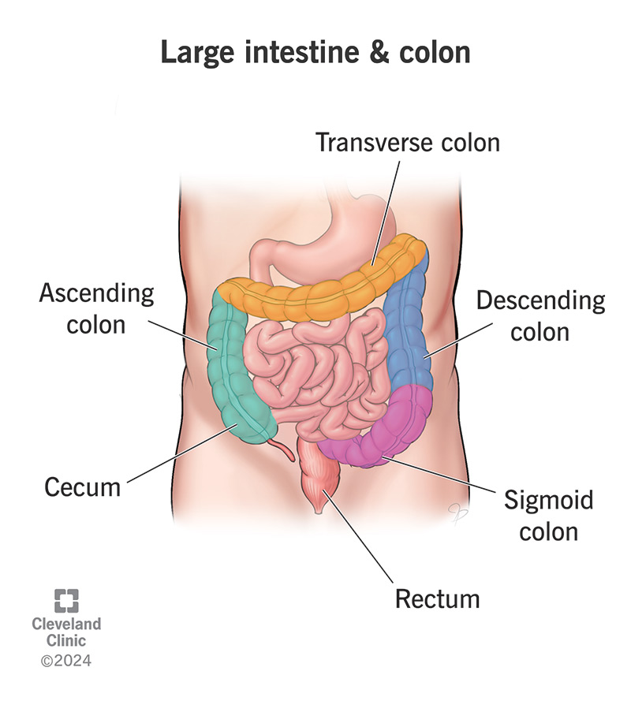

Slide 46
Functions of the Large Intestine
Absorption
  Absorbs water and electrolytes (Na+, Cl–) → makes feces semi-solid.
Formation of Feces
  Undigested food, dead cells, bacteria, mucus → form feces.
Bacterial Activity
  Gut bacteria help in fermentation of some undigested material.
  Produce vitamins like Vitamin K, B-complex (biotin, folic acid).
Defecation
  Removes waste material from the body.

Slide 47
Accessory Organs
Liver: Produces bile
Gallbladder: Stores and releases bile
Pancreas: Produces digestive enzymes & bicarbonate

Slide 48
1. Liver
Largest gland in the body (weighs ~1.5 kg).
Location: Upper right side of the abdomen.
Functions in digestion:
  Produces bile (a greenish fluid).
  Bile contains bile salts which emulsify fats (break large fat globules into small droplets → easier for enzymes to digest).
Other functions (non-digestive): stores glycogen, detoxifies blood, produces plasma proteins, etc.

Slide 49
2. Gallbladder
Small pear-shaped sac under the liver.
Function in digestion:
  Stores and concentrates bile made by the liver.
  Releases bile into the duodenum (small intestine) via the bile duct when fatty food is present.

Slide 50
3. Pancreas
Soft, leaf-shaped gland located behind the stomach.
Functions in digestion:
  Produces digestive enzymes:
    Amylase → breaks starch into simple sugars.
    Lipase → breaks fats into fatty acids & glycerol.
    Proteases (trypsin, chymotrypsin) → break proteins into amino acids.
    Produces bicarbonate → neutralizes the acidic chyme from the stomach, making the small intestine alkaline (so enzymes can work).

Slide 51
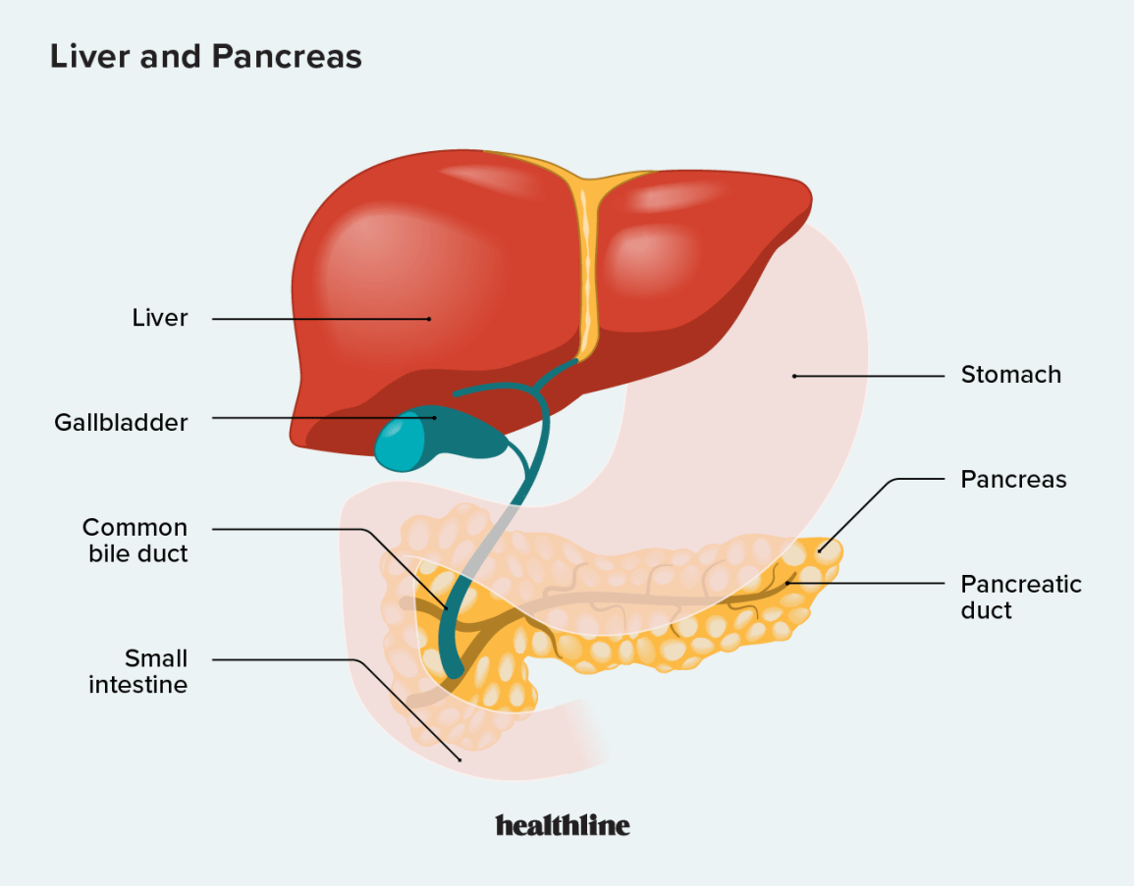

Slide 52
Physiology – Digestive Processes
1. Ingestion
2. Propulsion (swallowing, peristalsis)
3. Mechanical digestion (chewing, churning)
4. Chemical digestion (enzymes, acids)
5. Absorption
6. Defecation

Slide 53
1. Gastroesophageal Reflux Disease (GERD / Acid Reflux)
Definition: A chronic condition in which stomach acid frequently flows back into the esophagus, causing irritation.
Causes: Weak lower esophageal sphincter, obesity, smoking, spicy/fatty foods.
Symptoms: Heartburn, sour/bitter taste, chest pain, cough at night.
Treatment: Avoid trigger foods, weight loss, antacids, proton pump inhibitors (omeprazole), H2 blockers (famotidine).

Slide 54
2. Gastritis
Definition: Inflammation of the stomach lining.
Causes: H. pylori infection, alcohol, spicy food, long-term NSAID use.
Symptoms: Stomach pain, nausea, vomiting, bloating, indigestion.
Treatment: Antibiotics (for H. pylori), PPIs, H2 blockers, avoid irritant foods, reduce alcohol/NSAIDs.

Slide 55
3. Peptic Ulcer (Stomach or Duodenal Ulcer)
Definition: Open sores that develop on the inner lining of the stomach or upper small intestine.
Causes: H. pylori infection, excess stomach acid, stress, smoking, NSAIDs.
Symptoms: Burning stomach pain (worse at night or empty stomach), bloating, nausea, black or tarry stool.
Treatment: Triple therapy (antibiotics + PPI), antacids, avoid NSAIDs, stress reduction.

Slide 56
4. Irritable Bowel Syndrome (IBS)
Definition: A functional bowel disorder characterized by abdominal pain and altered bowel habits without structural damage.
Causes: Stress, abnormal gut motility, certain foods (dairy, caffeine, fatty food).
Symptoms: Abdominal pain, bloating, alternating constipation and diarrhea, mucus in stool.
Treatment: High-fiber diet, stress management, antispasmodics (dicyclomine), laxatives (for constipation), antidiarrheals (loperamide).

Slide 57
5. Inflammatory Bowel Disease (IBD – Crohn’s Disease & Ulcerative Colitis)
Definition: Chronic inflammation of the gastrointestinal tract due to autoimmune response.
Causes: Autoimmune disorder, genetics, abnormal immune response.
Symptoms: Severe diarrhea, abdominal cramps, blood in stool, weight loss, fever, fatigue.
Treatment: Anti-inflammatory drugs (5-ASA), corticosteroids, immunosuppressants, biologic therapy, surgery if severe.

Slide 58
6. Constipation
Definition: Difficulty or infrequent bowel movements, often with hard and dry stools.
Causes: Low fiber diet, dehydration, lack of exercise, medications (iron, painkillers).
Symptoms: Hard stools, difficulty passing stool, infrequent bowel movements.
Treatment: High-fiber foods, drink plenty of water, exercise, stool softeners, mild laxatives (short-term).

Slide 59
7. Diarrhea
Definition: Frequent loose or watery bowel movements.
Causes: Infections (bacteria, viruses, parasites), contaminated food/water, food intolerance.
Symptoms: Frequent watery stools, abdominal cramps, dehydration, weakness.
Treatment: Oral rehydration solution (ORS), IV fluids if severe, antibiotics (if bacterial), probiotics.

Slide 60
8. Hemorrhoids (Piles)
Definition: Swollen and inflamed veins in the rectum or anus.
Causes: Chronic constipation, pregnancy, prolonged sitting, straining during bowel movements.
Symptoms: Pain, itching, swelling around anus, bleeding during defecation.
Treatment: High-fiber diet, sitz baths, topical creams, pain relievers, surgery if severe.

Slide 61
9. Gallstones (Cholelithiasis)
Definition: Hardened deposits of bile (cholesterol, pigments) that form in the gallbladder.
Causes: Excess cholesterol in bile, obesity, fatty diet, female gender.
Symptoms: Severe upper right abdominal pain (after fatty meals), nausea, vomiting, bloating.
Treatment: Pain management, low-fat diet, surgical removal of gallbladder (cholecystectomy) if recurrent.

Slide 62
10. Hepatitis (A, B, C, etc.)
Definition: Inflammation of the liver, usually caused by viral infection.
Causes: Contaminated food/water (Hep A, E), blood contact or sexual transmission (Hep B, C).
Symptoms: Jaundice (yellow skin/eyes), dark urine, fatigue, nausea, abdominal pain.
Treatment: Rest, antiviral drugs (for Hep B & C), vaccines (for Hep A & B), avoid alcohol, supportive care.

Slide 63
Summary
GIT: Specialized organs for digestion & absorption
Accessory organs: Essential for chemical digestion
Understanding anatomy & physiology aids in diagnosing digestive disorders

Slide 64
References
Guyton & Hall, Textbook of Medical Physiology
Tortora & Derrickson, Principles of Anatomy & Physiology

